Slide 1
Simulation and parameter estimation with rxode and nlmixr
Rik Schoemaker, PhD
On behalf of the nlmixr development team:
Matt Fidler, Bill Denney, Richard Hooijmaijers, Rik Schoemaker, Mirjam Trame, Theodoros Papathanasiou, Justin Wilkins, Yuan Xiong, John Harrold, Huijuan Xu

Slide 2
Course outline
Introduction to rxode2 simulation
Introduction to nlmixr2 and parameter estimation
Hands on with the warfarin PK models (part 1)
Advanced capabilities nlmixr
Hands on with the warfarin PK and PKPD models (part 2)

Slide 3
rxode2 simulation software in R
rxode2 is pharmacometric simulation software using ordinary differential equations (ODEs) as an open-source R package
Rewritten by Matt Fidler after Wenping Wang’s original RxODE package, available on CRAN¹ and GitHub², and described in a tutorial in CPT:PSP³ and with online documentation⁴
Simulation of ODEs was already possible in R (using deSolve), but was slow and virtually impossible to code with flexible dosing history
rxode2 has rapid execution due to compilation in C
rxode2 allows fully flexible dosing history
Stable and mature software for Windows, OS X (in docker), Linux
Requires external compilers (provided by Rtools on Windows)
rxode2 is an evolution of the original RxODE package: after a full re-write of the code backward compatibility could not be guaranteed
[1] CRAN: https://cran.r-project.org/web/packages/rxode2
[2] GitHub: https://github.com/nlmixr2/rxode2
[3] Wang W et al. CPT:PSP (2016) 5, 3–10.
[4] RxODE packagedown: https://nlmixr2.github.io/rxode2

Slide 4
Basic example load the library and define the ODEs
library(rxode2)
## set up the system of differential equations (ODEs) odeKA1 <- " d/dt(depot) = -ka*depot; # This is compartment number 1 (depot) d/dt(central) = ka*depot-(cl/v)*central; # This is compartment number 2 (central) C1=central/v; # Calculates concentration from amount "

Slide 5
Compile the model and set the parameter values
library(rxode2)
## set up the system of differential equations (ODEs) odeKA1 <- " d/dt(depot) = -ka*depot; # This is compartment number 1 (depot) d/dt(central) = ka*depot-(cl/v)*central; # This is compartment number 2 (central) C1=central/v; # Calculates concentration from amount " ## compile the model modKA1 <- RxODE(model = odeKA1) ## provide the parameter values to be simulated: Params <- c(ka = log(2)/0.5, # 1/h (absorption half-life of 30 minutes) cl = 0.135, # L/h v = 8) # L

Slide 6
Create an eventTable that defines the doses and the sampling times
library(rxode2)
## set up the system of differential equations (ODEs) odeKA1 <- " d/dt(depot) = -ka*depot; # This is compartment number 1 (depot) d/dt(central) = ka*depot-(cl/v)*central; # This is compartment number 2 (central) C1=central/v; # Calculates concentration from amount " ## compile the model modKA1 <- RxODE(model = odeKA1) ## provide the parameter values to be simulated: Params <- c(ka = log(2)/0.5, # 1/h (absorption half-life of 30 minutes) cl = 0.135, # L/h v = 8) # L ## create an empty event table that stores both dosing and sampling information : ev <- eventTable()
## add a dose to the event table: ev$add.dosing(dose = 500) #mg
## add time points to the event table where concentrations will be simulated
## these actions are cumulative ev$add.sampling(seq(0, 120, 0.1))

Slide 7
Solve the equations and plot the results
library(rxode2)
## set up the system of differential equations (ODEs) odeKA1 <- " d/dt(depot) = -ka*depot; # This is compartment number 1 (depot) d/dt(central) = ka*depot-(cl/v)*central; # This is compartment number 2 (central) C1=central/v; # Calculates concentration from amount " ## compile the model modKA1 <- RxODE(model = odeKA1) ## provide the parameter values to be simulated: Params <- c(ka = log(2)/0.5, # 1/h (absorption half-life of 30 minutes) cl = 0.135, # L/h v = 8) # L ## create an empty event table that stores both dosing and sampling information : ev <- eventTable() ## add a dose to the event table: ev$add.dosing(dose = 500) #mg ## add time points to the event table where concentrations will be simulated
## these actions are cumulative ev$add.sampling(seq(0, 120, 0.1)) ## Then solve the system ## The output from rxSolve is a solved RxODE object, ## By making it a data.frame only the simulated values are retained: Res <- data.frame(rxSolve(modKA1, Params, ev))

Slide 8
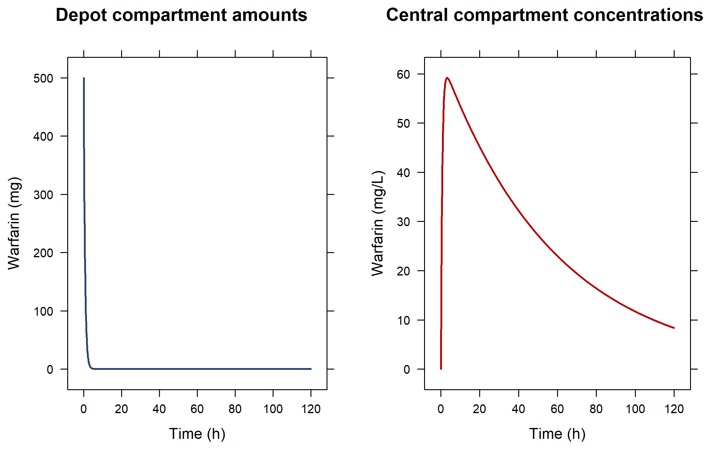
Single bolus dose in the first (depot) compartment

Slide 9
Adding extra doses (expand the existing eventTable): three additional infusions in the central compartment
## Extend the eventTable by adding three infusions to the central compartment ## Remember: updates to the eventTable are cumulative ev$add.dosing( dose = 250, #mg nbr.doses = 3, #add three doses dosing.to = 2, #add them to the second ODE in the model (=central) dosing.interval = 12, #h; set the doses 12 hours apart rate = 125, #mg/h; infuse at a rate of 125 mg/h, resulting in 2-hour infusions start.time = 36 #h; have the three doses start at 36h ) Res <- data.frame(rxSolve(modKA1, Params, ev))

Slide 10
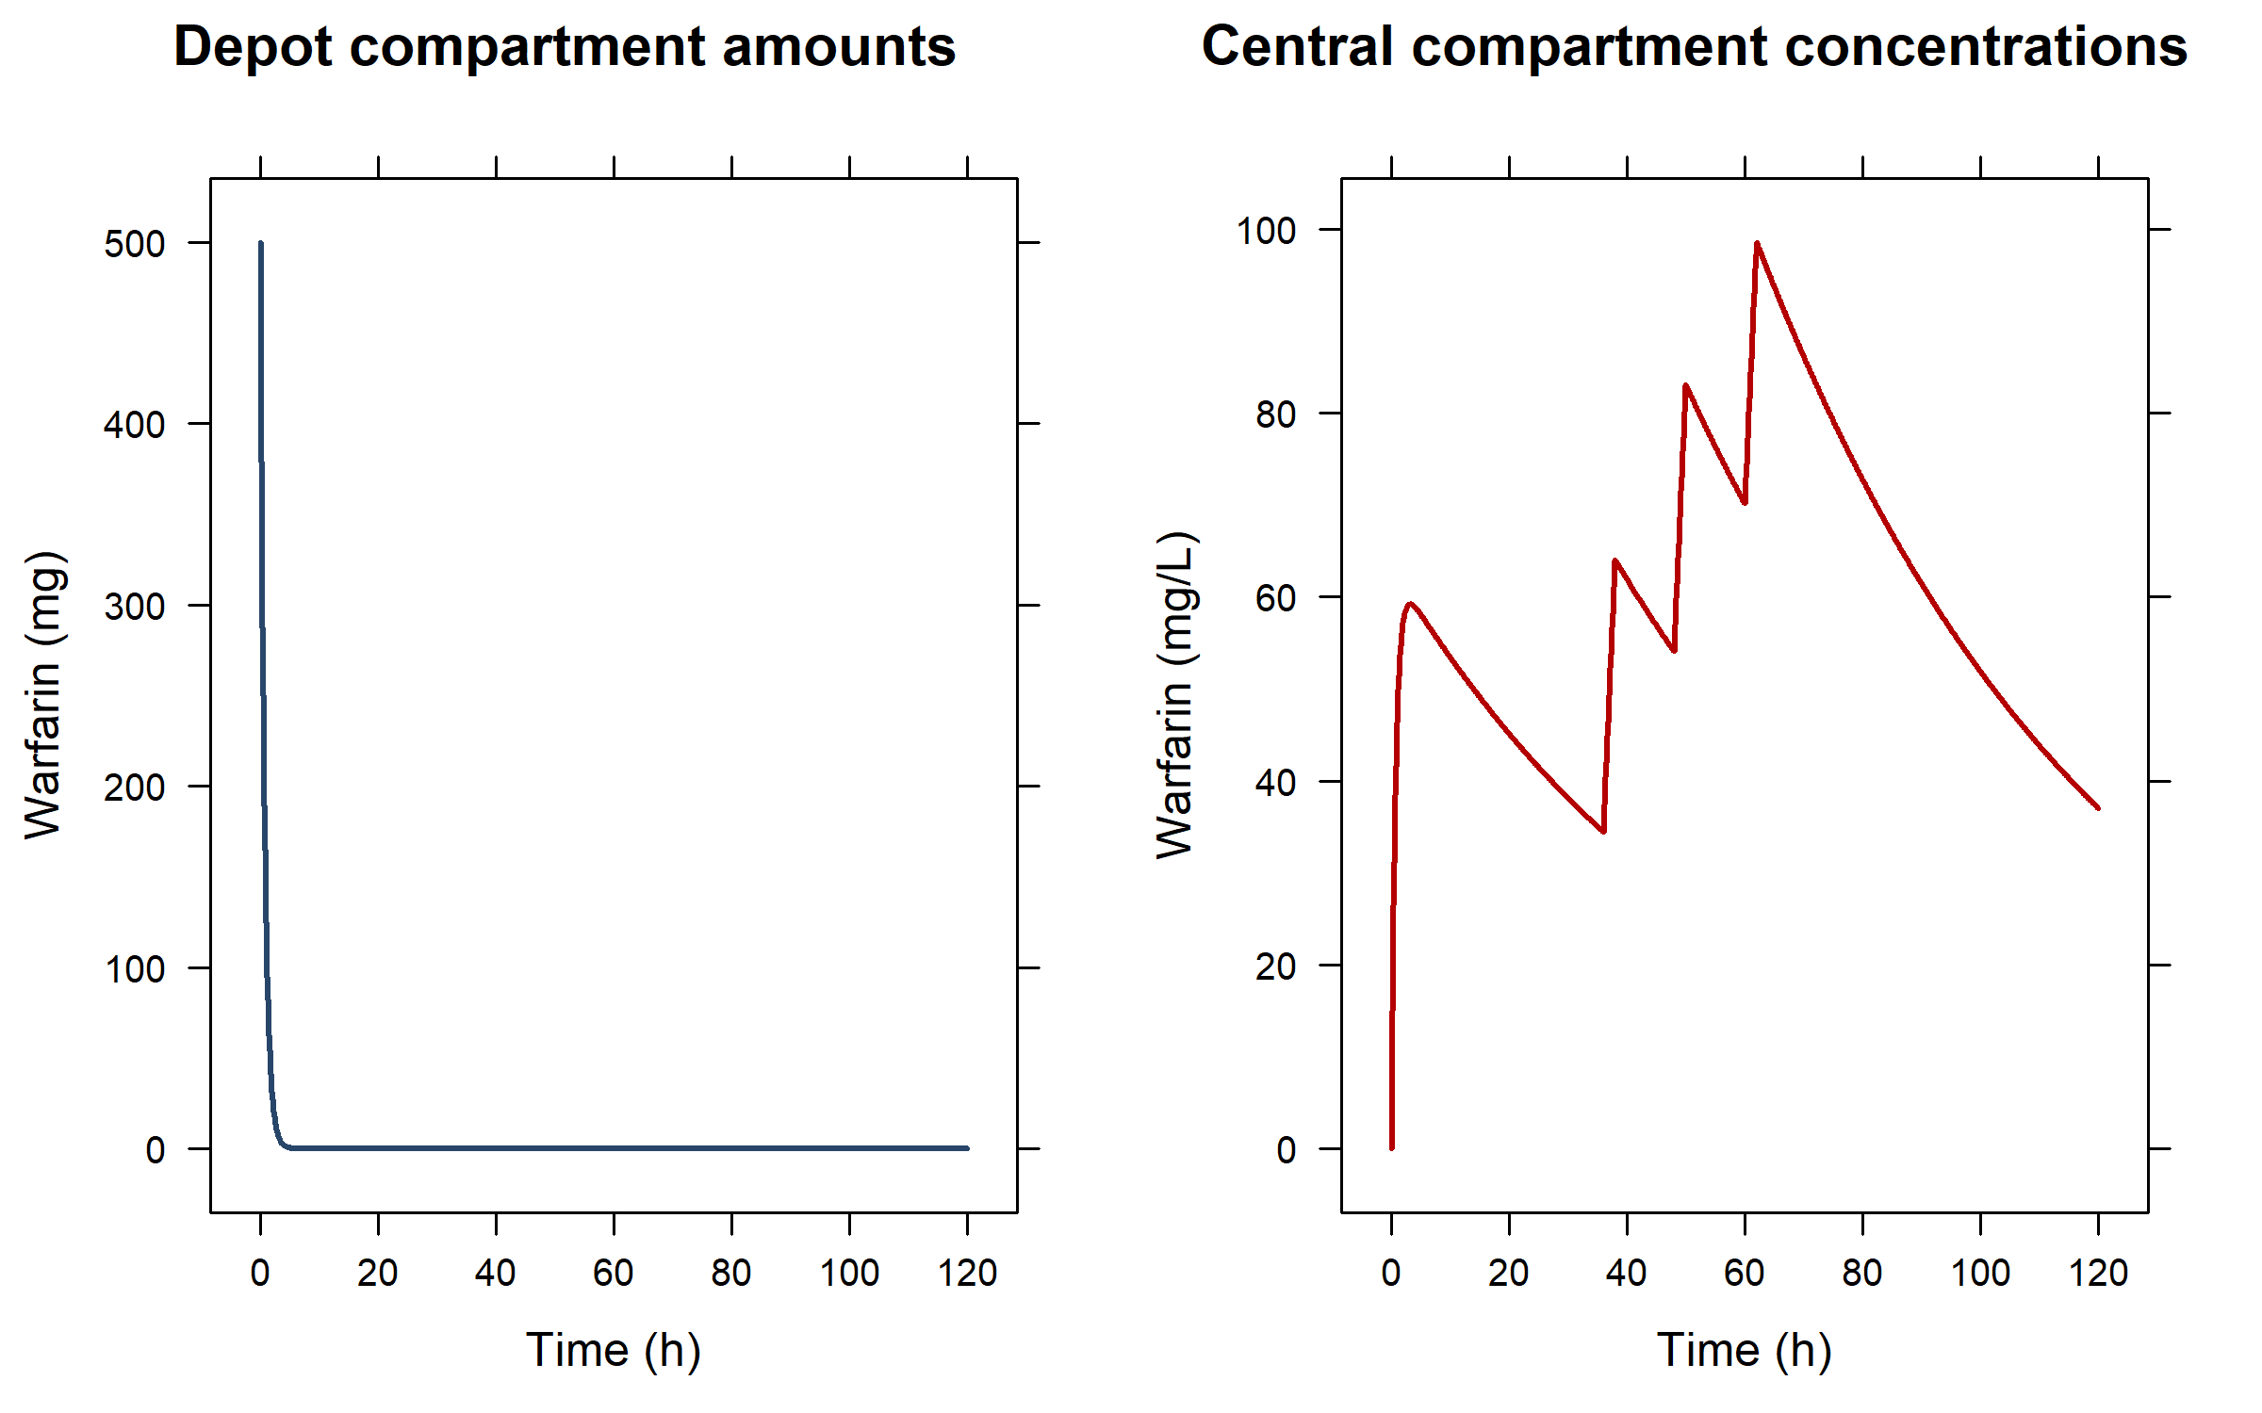
Multiple dose in different compartments Only the first dose goes into the depot (first) compartment

Slide 11
Extend the model: add a transit compartment…
odeKA1trans <- " d/dt(depot) = -ka*depot; d/dt(central) = ktr*trans-(cl/v)*central; # update to central: input from trans d/dt(trans) = ka*depot-ktr*trans; # transit compartment between depot and central C1=central/v; " ## compile the model modKA1trans <- RxODE(model = odeKA1trans) ## provide the extra ktr parameter: Params2 <- c( ka = log(2)/0.5, # 1/h (absorption half-life of 30 minutes) cl = 0.135, # L/h v = 8, # L ktr = log(2)/5) # 1/h (transit half-life of 5 hours) ## the eventTable does not have to change Res <- data.frame(rxSolve(modKA1trans, Params2, ev))
## if the trans compartment had been put as second compartment above,
## the eventTable would need an update to infuse in compartment 3 instead

Slide 12
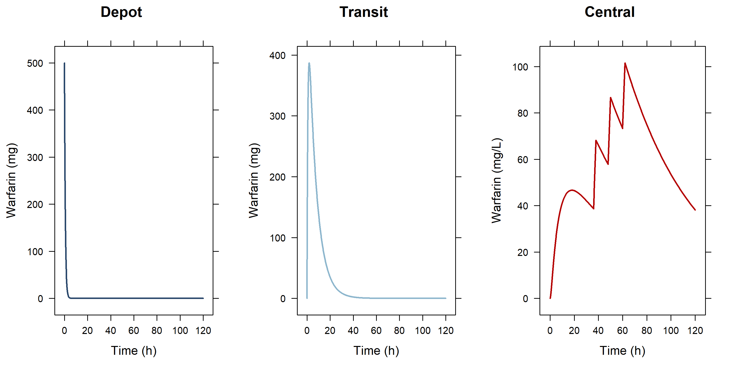
...adding a transit compartment between depot and central

Slide 13
Or with five transit compartments and only bolus doses in the depot…
odeKA5trans <- " d/dt(depot) = -ktr*depot; d/dt(central) = ktr*trans5-(cl/v)*central; # update to central: input from trans5 d/dt(trans1) = ktr*depot-ktr*trans1; # use same constant for every compartment d/dt(trans2) = ktr*trans1-ktr*trans2; d/dt(trans3) = ktr*trans2-ktr*trans3; d/dt(trans4) = ktr*trans3-ktr*trans4; d/dt(trans5) = ktr*trans4-ktr*trans5; C1=central/v; " ev3 <- eventTable() ev3$add.dosing(dose = 500) # mg; 1st bolus ev3$add.dosing( dose = 250, # mg nbr.doses = 3, # 3 additional doses (bolusses because rate is absent so rate=0)
dosing.interval = 12, # h; at 12 hour intervals dosing.to = 1, # dosed into depot (compartment 1) start.time = 36 # h; starting at 36 hours ) ev3$add.sampling(seq(0, 120, 0.1)) Params3 <- c(ktr = log(2)/1, # use same constant for every compartment cl = 0.135, v = 8) modKA5trans <- RxODE(model = odeKA5trans) Res <- data.frame(rxSolve(modKA5trans, Params3, ev3))

Slide 14
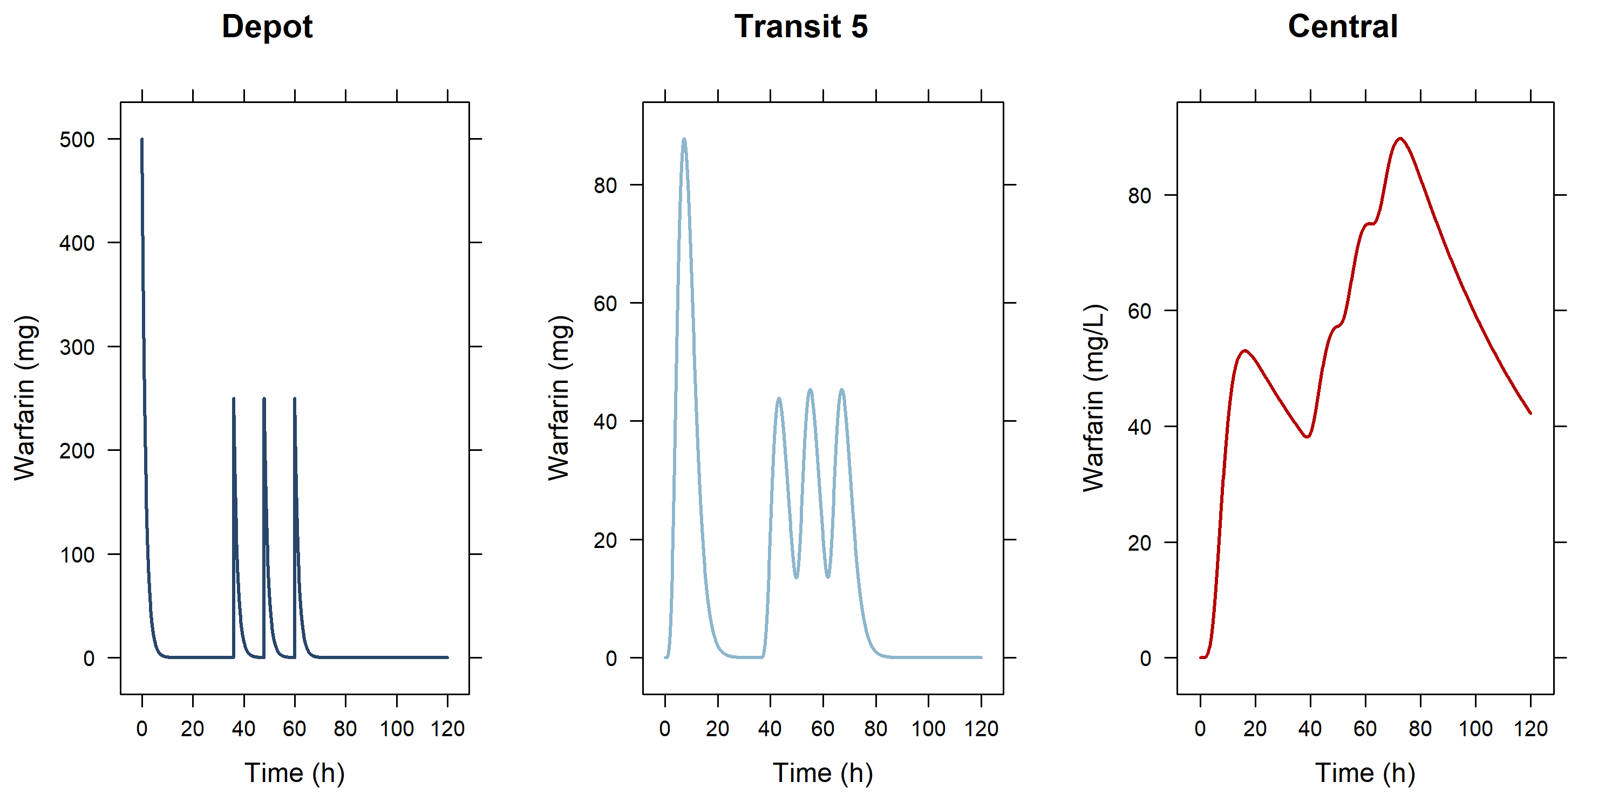
...adding 5 transit compartments between depot and central and giving 4 bolus doses in the 1st (depot) compartment

Slide 15
Hands-on session I: rxode2 simulations
Examine the code in PAGE_1.R to run pre-programmed simulations and try out your own variations

Slide 16
Assess the data before you start analysis
Classic data sets used by Nick Holford in his courses:
O'Reilly RA, Aggeler PM. Studies on coumarin anticoagulant drugs initiation of warfarin therapy without a loading dose. Circulation 1968;38:169-177
O'Reilly RA, Aggeler PM, Leong LS. Studies of the coumarin anticoagulant drugs: The pharmacodynamics of warfarin in man. Journal of Clinical Investigation 1963;42(10):1542-1551
Some simple lattice plots to get a feel of the data
Additional xgxr plots to summarize the profiles

Slide 17
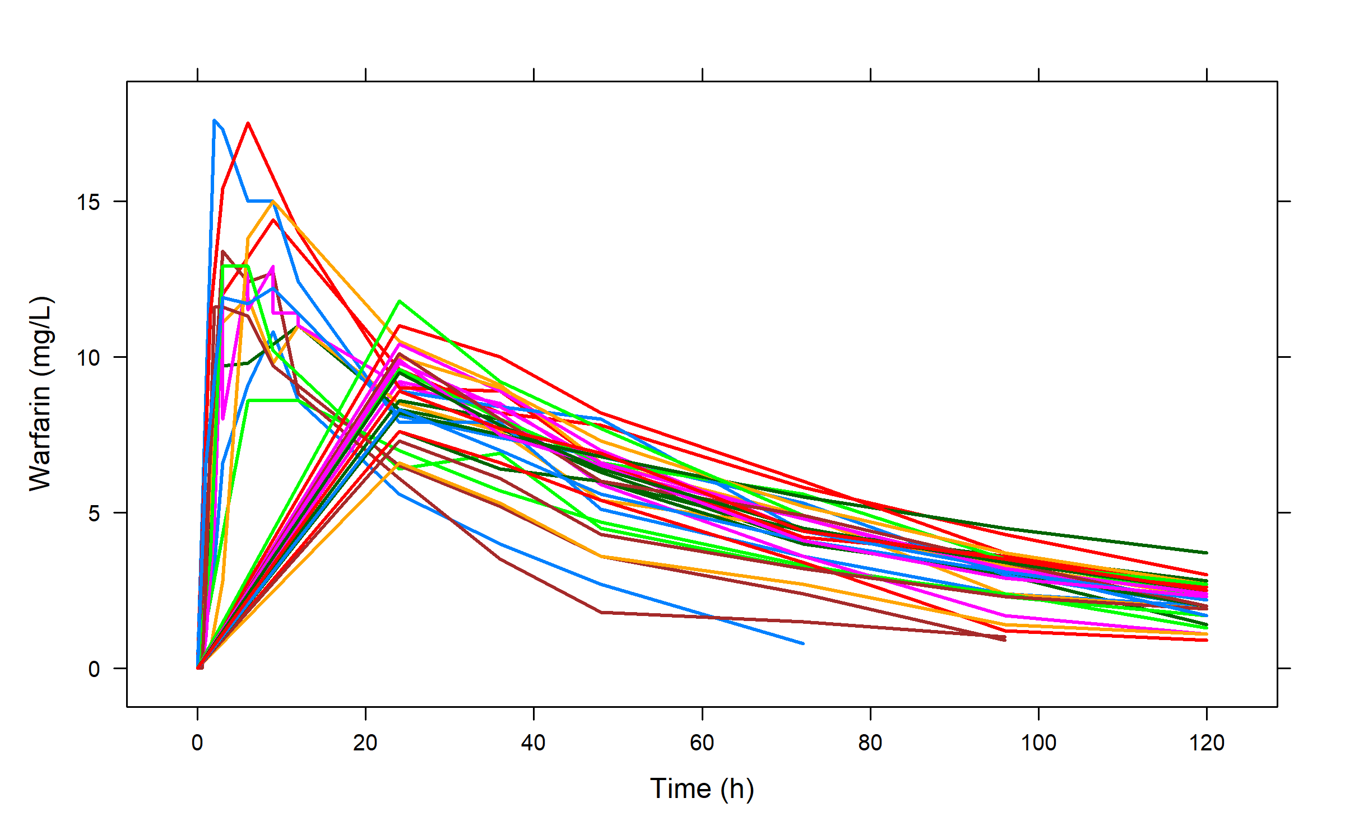
Our warfarin data file: a simple lattice plot to provide an impression

Slide 18
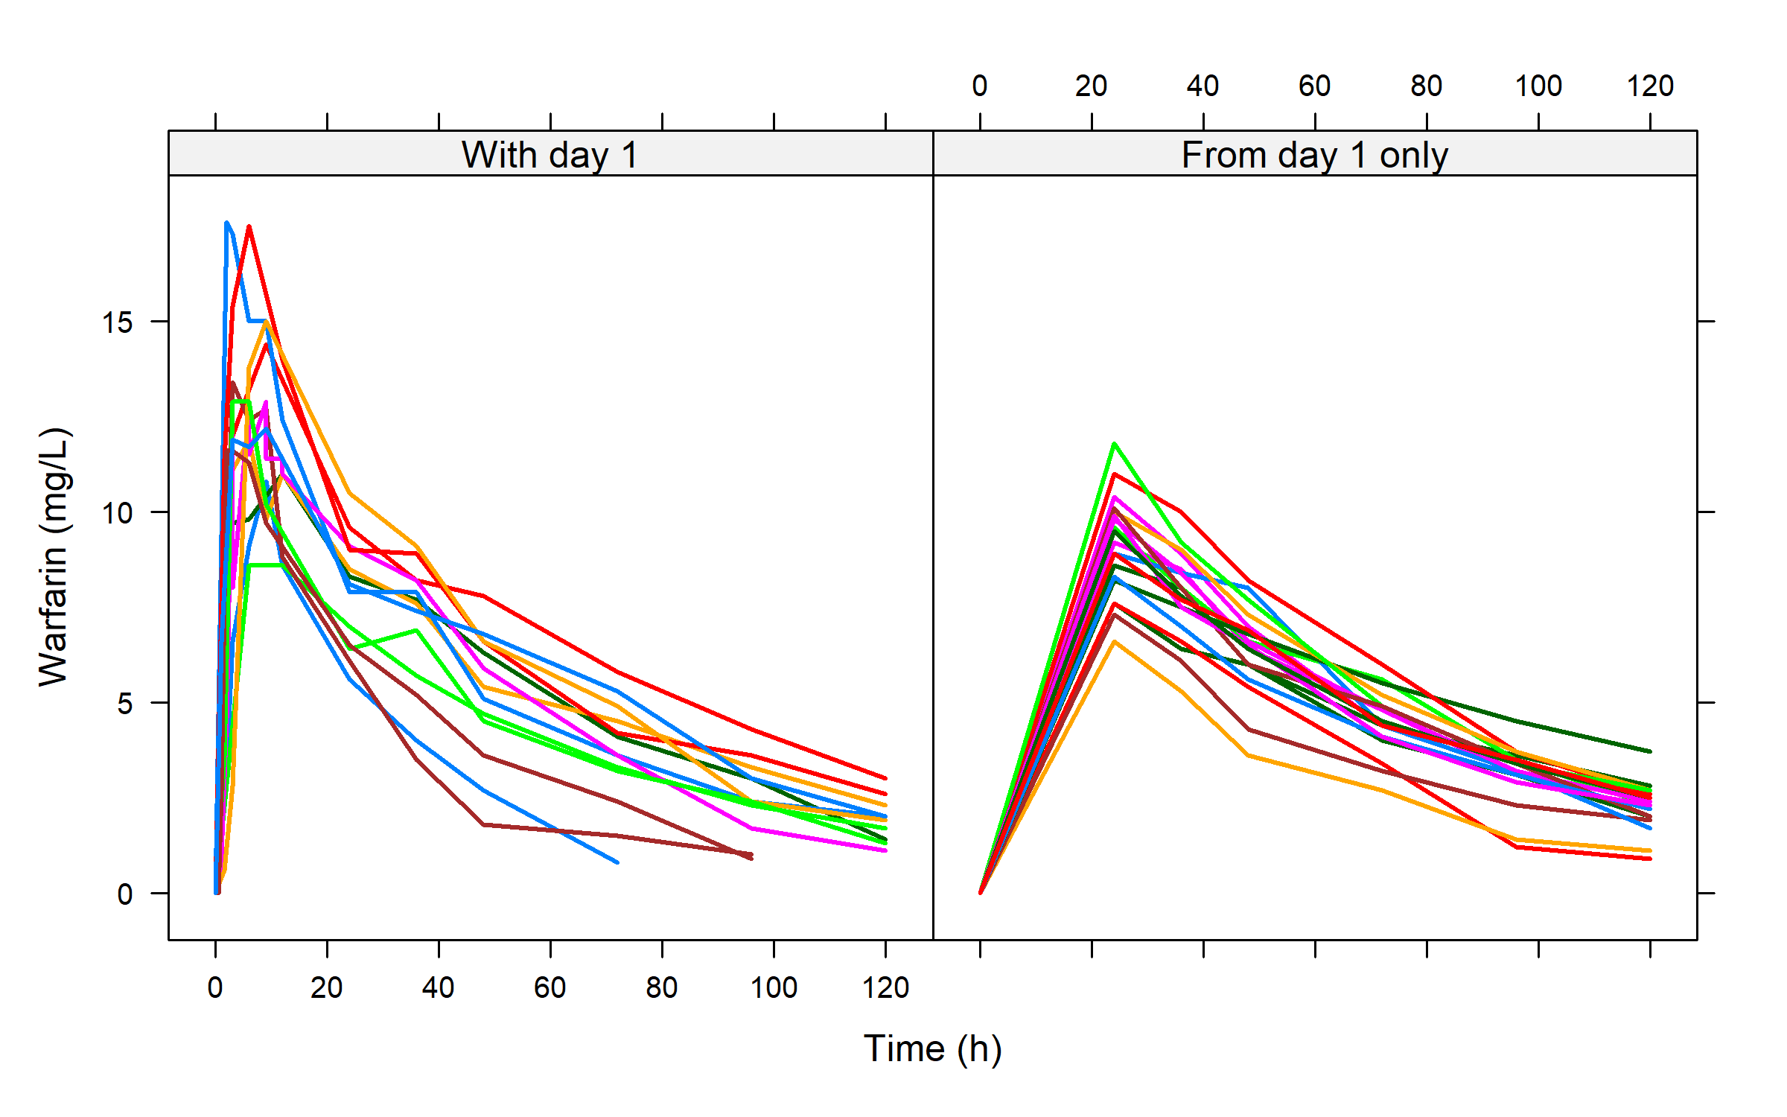
Subjects with and without information on absorption on day 1

Slide 19
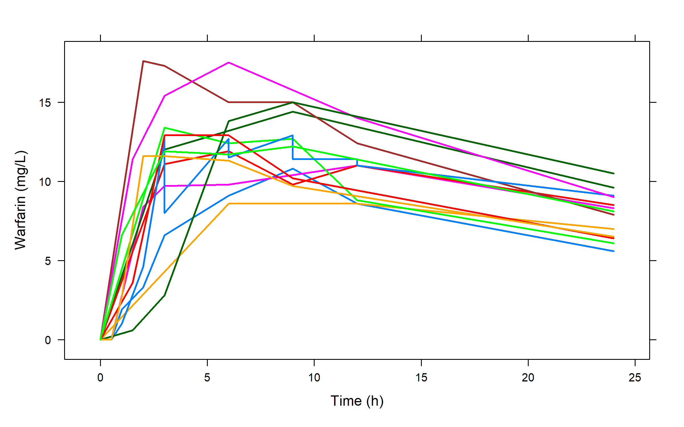
A closer look at the information on absorption on day 1

Slide 20
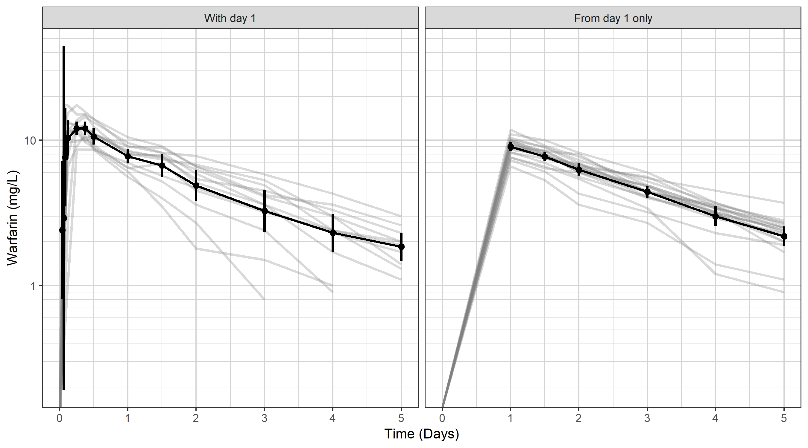
Exploratory xgx graph on logarithmic scale with mean and SD error bars at scheduled time points

Slide 21
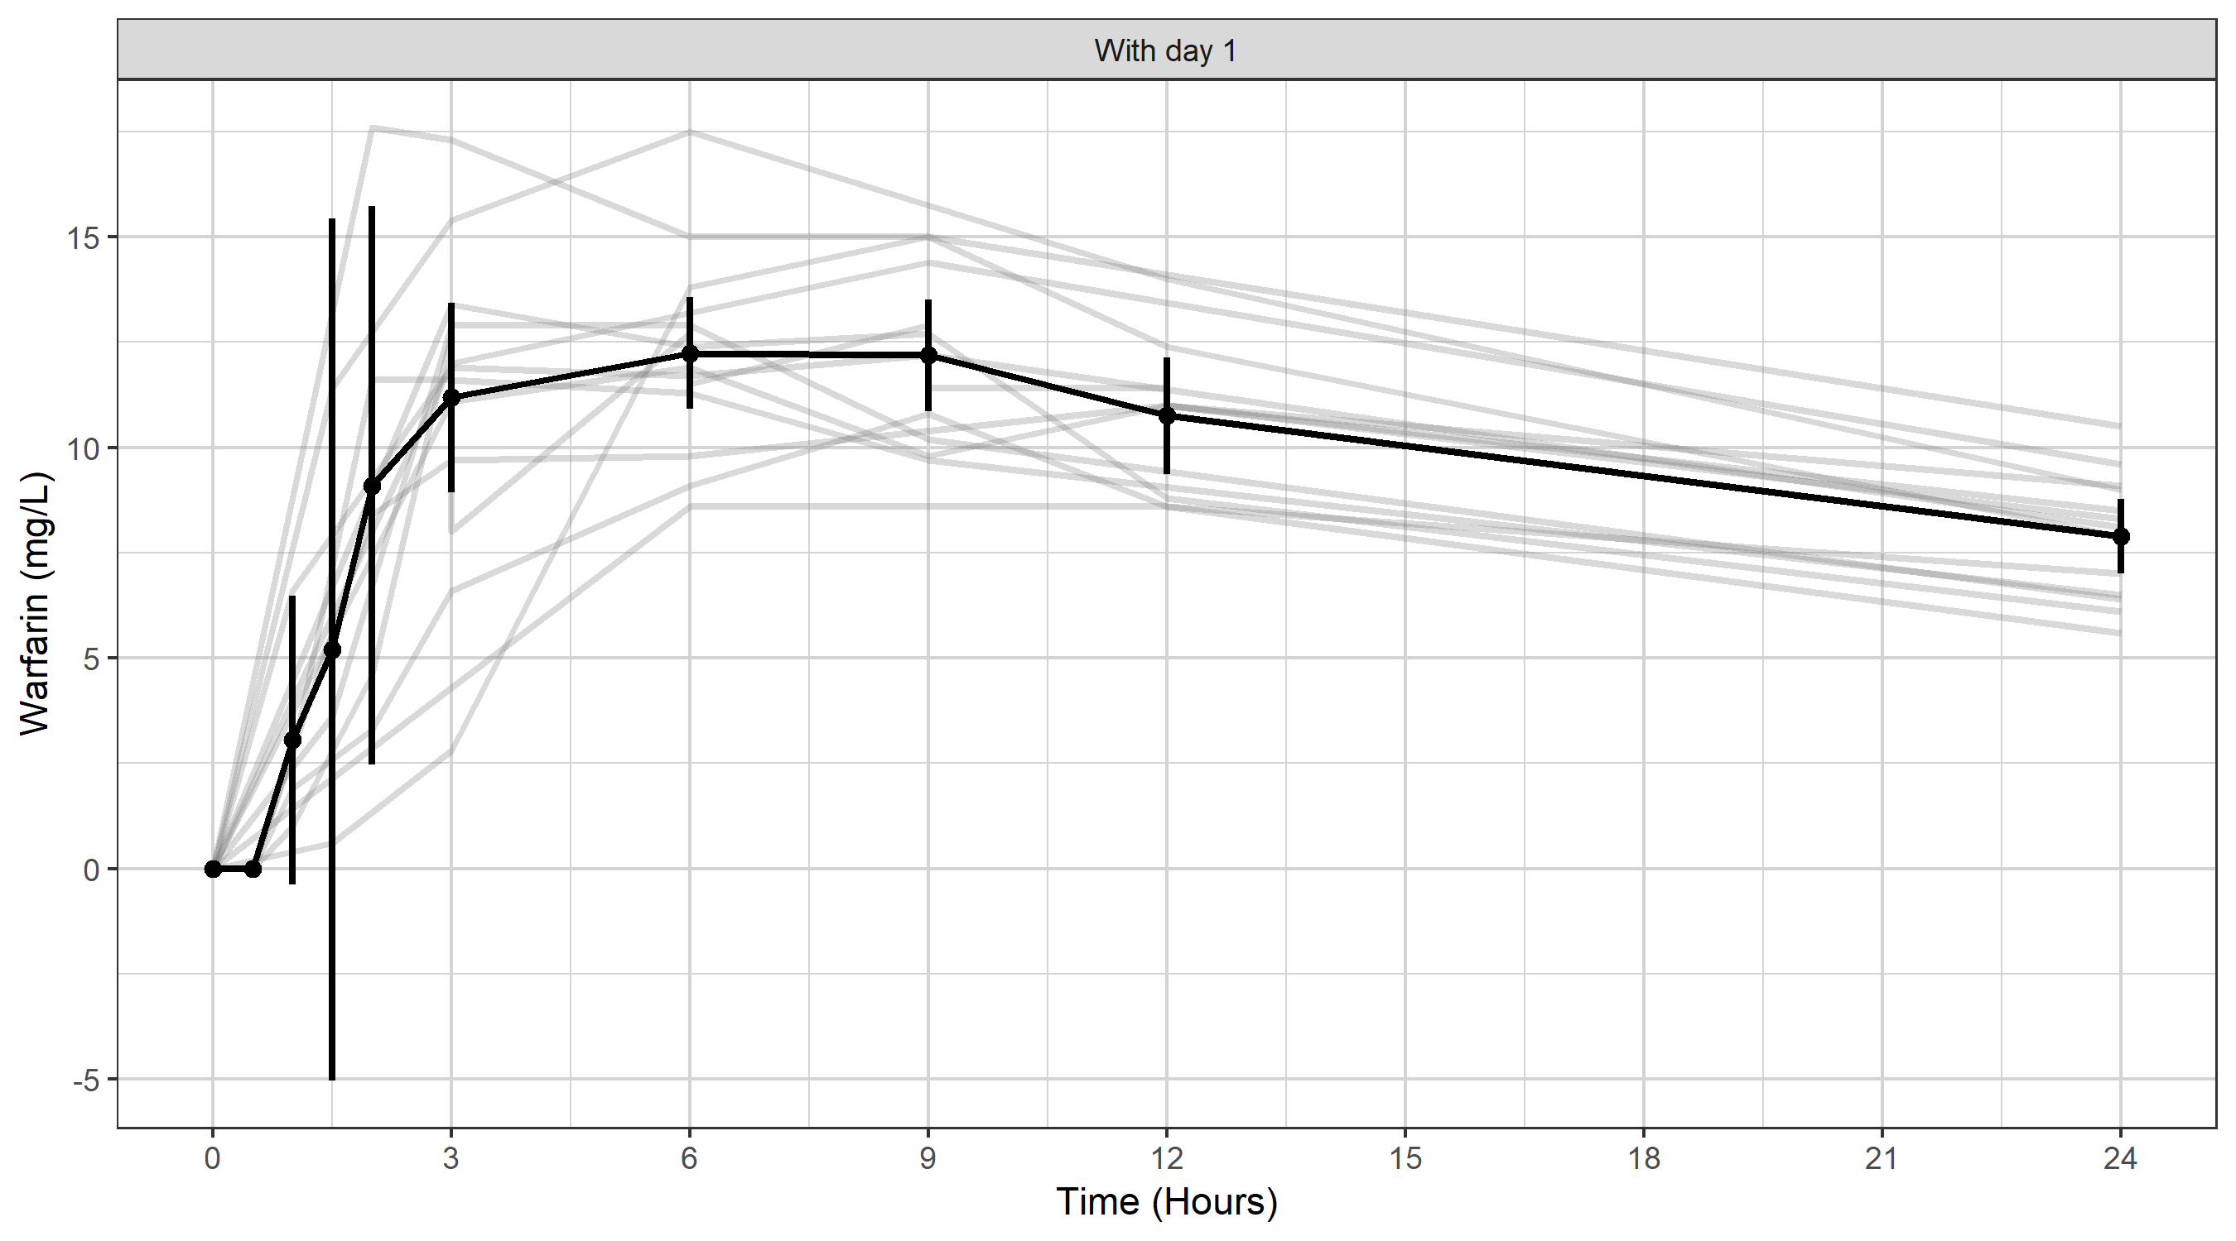
Focusing on absorption: first 24 hours on linear scale

Slide 22
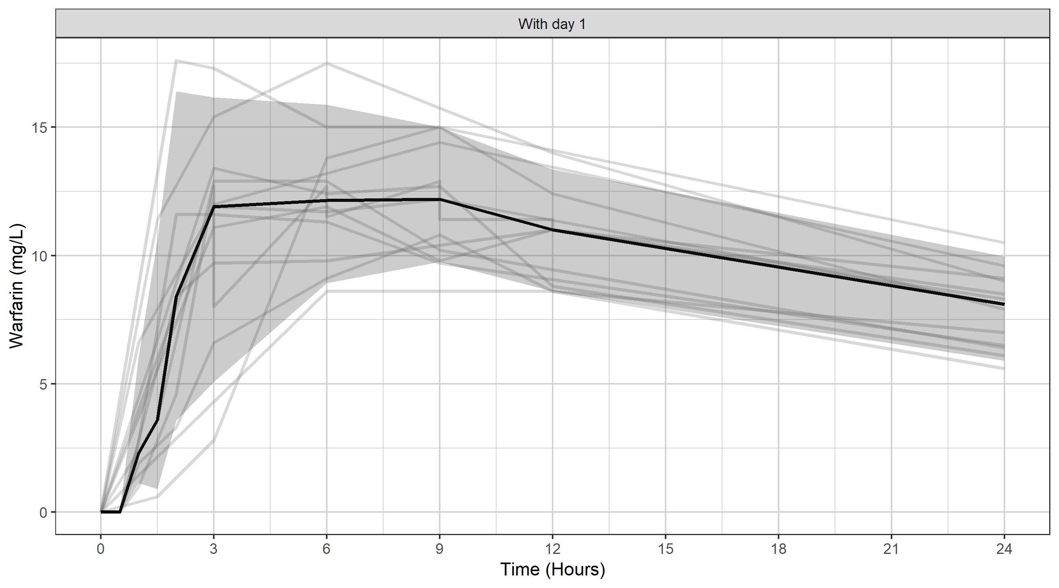
Or with median and 95% of the data

Slide 23
You need to simulate before you can estimate
With simulation covered, you can start to think about estimation
Combine the simulation core with estimation routines and you get:
nlmixr!

Slide 24
nlmixr² is an open-source R package
Written by Wenping Wang and Matt Fidler, and available on CRAN¹ and GitHub²:
builds on rxode2
combined with SAEM, and FOCEI estimation routines, provides an R package for parameter estimation in nonlinear mixed effect models
under very active development!
nlmixr² is completely free and open source, and does not depend on any other commercial tool such as NONMEM or Monolix
nlmixr² provides an efficient and versatile way to specify pharmacometric models (both closed-form and ODEs) and dosing scenarios, with rapid execution due to compilation in C
[1] https://cran.r-project.org/web/packages/nlmixr2
[2] https://github.com/nlmixr2/nlmixr2

Slide 25
nlmixr² is a well-embedded open-source R package
nlmixr² is fully supported by ggPMX¹
Additionally, xpose.nlmixr2² written by Justin Wilkins provides linkage to the new xpose package³, written by Ben Guiastrennec, feeding the uniform output into a highly flexible diagnostics package
The shinyMixR⁴ project management tool written by Richard Hooijmaijers and Teun Post provides an interface to nlmixr² from both the R command line and a user-friendly browser-based Shiny dashboard application
nlmixr² requires access to compilers, easily installed using Rtools on Windows⁵
Installation is very simple from CRAN:
install.packages("nlmixr2",dependencies=TRUE)
Documentation is available in the form of a bookdown (nlmixr2.org)⁶ with a dedicated nlmixr blog (blog.nlmixr2.org)
Runs on Windows, Linux, and OS X, and a Docker install is available
[1] https://cran.r-project.org/web/packages/ggPMX/ and https://github.com/ggPMXdevelopment/ggPMX
[2] https://github.com/nlmixr2/xpose.nlmixr2 and https://cran.r-project.org/packages/xpose.nlmixr2
[3] https://cran.r-project.org/packages/xpose and https://uupharmacometrics.github.io/xpose/
[4] https://github.com/RichardHooijmaijers/shinyMixR and https://richardhooijmaijers.github.io/shinyMixR/articles/shinyMixR-vignette.html
[5] https://cran.r-project.org/bin/windows/Rtools/rtools42/rtools.html
[6] https://nlmixr2.github.io/nlmixr2

Slide 26
nlmixr performance: do I get the same results when I switch from my usual estimation tool to nlmixr?
Publication in CPT:PSP: Performance of the SAEM and FOCEI algorithms in the open-source non-linear mixed effect modelling tool nlmixr¹
nlmixr/FOCEI compared to NONMEM/FOCEI
nlmixr/SAEM compared to Monolix/SAEM
Repeated sparse data sets for a single model
A wide range of models and inputs using single rich data sets
Results for both FOCEI and SAEM are perfectly comparable to NONMEM and Monolix
[1] https://ascpt.onlinelibrary.wiley.com/doi/10.1002/psp4.12471

Slide 27
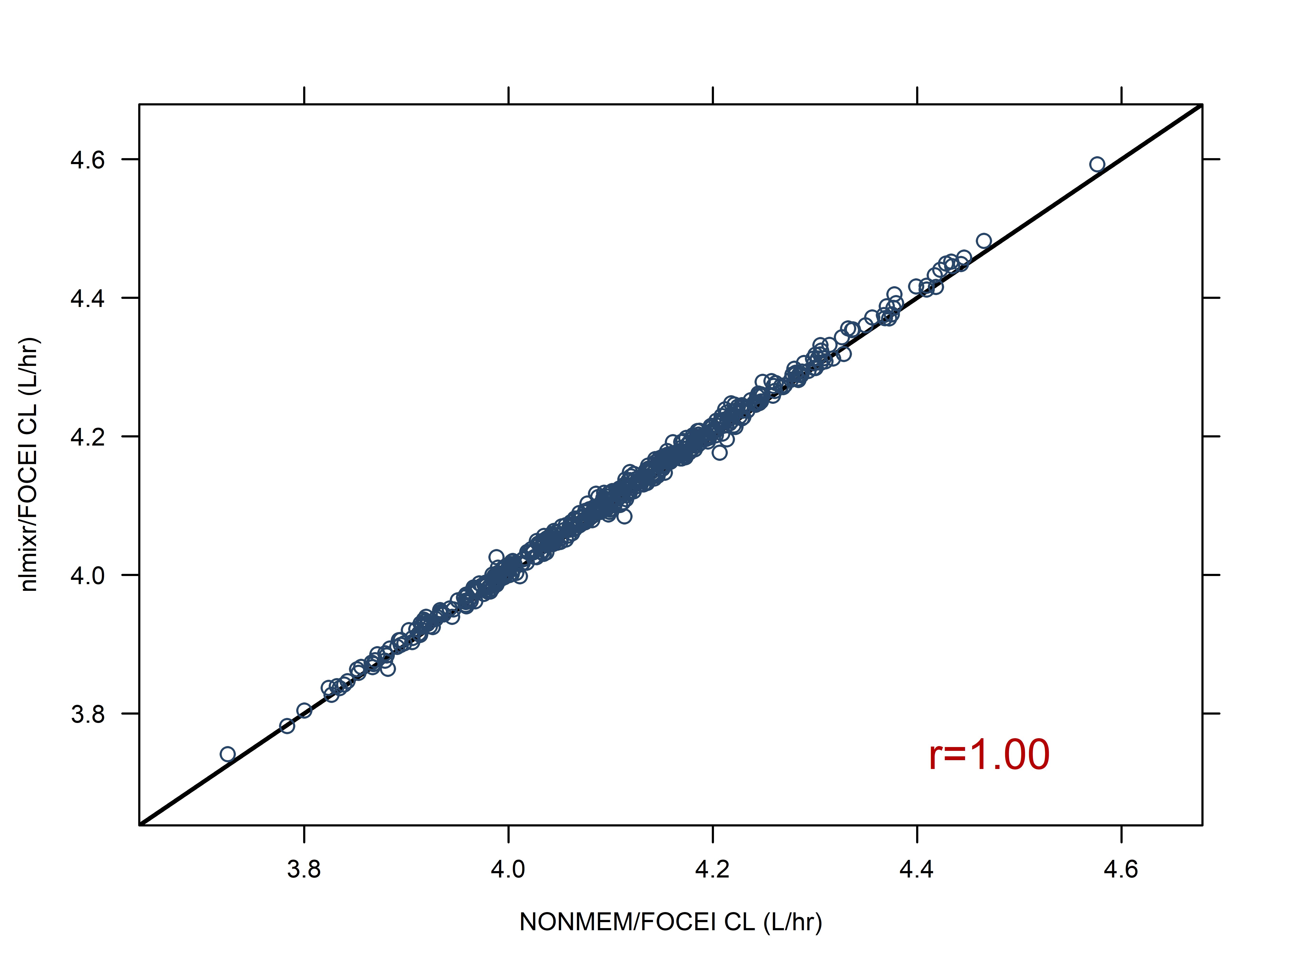
500 sparse data sets are analysed using both NONMEM/FOCEI and nlmixr/FOCEI. Each marker is a single paired data set result for clearance for NONMEM on the x-axis and nlmixr/FOCEI on the y-axis: results are highly correlated (r=1.00), and lie on the line of identity (diagonal black line)

Slide 28
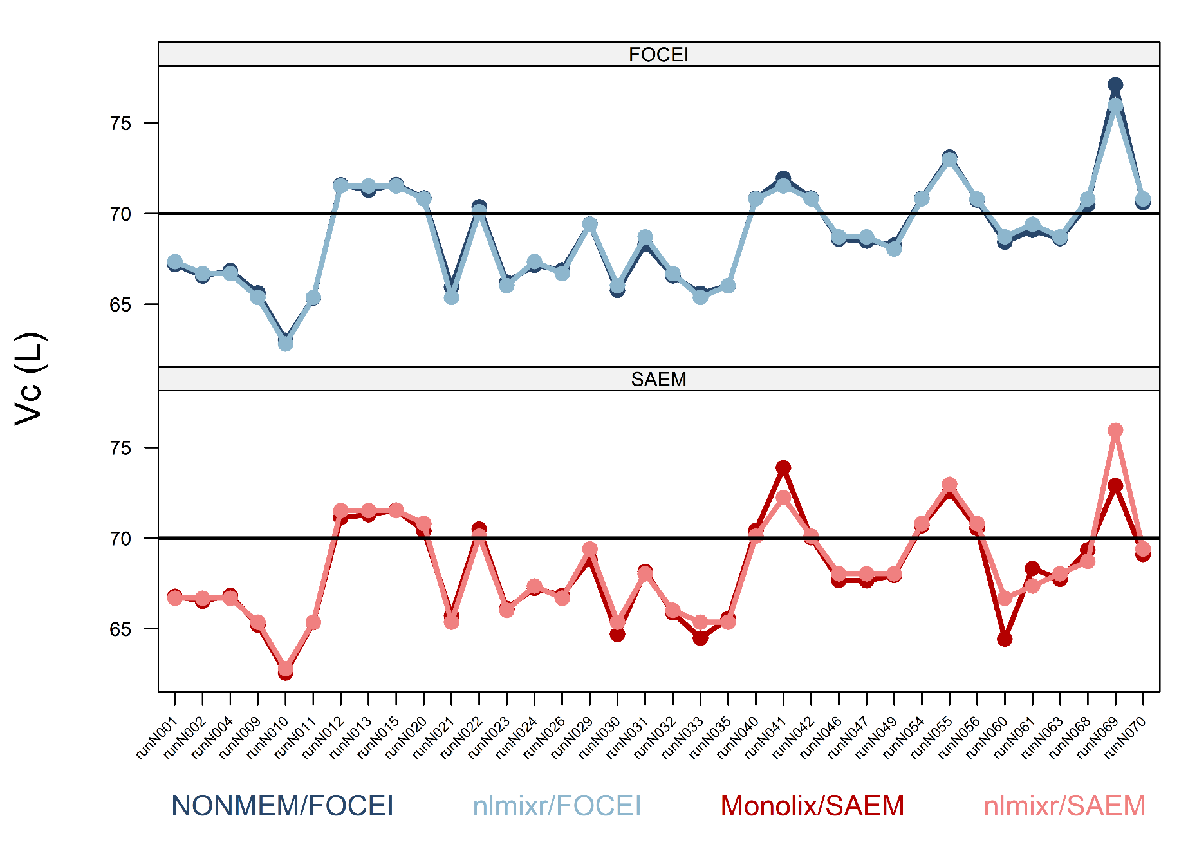
Central volume (Vc): Top panel: FOCEI estimates, bottom panel: SAEM estimates Dark lines: NONMEM/MONOLIX, light lines: nlmixr

Slide 29
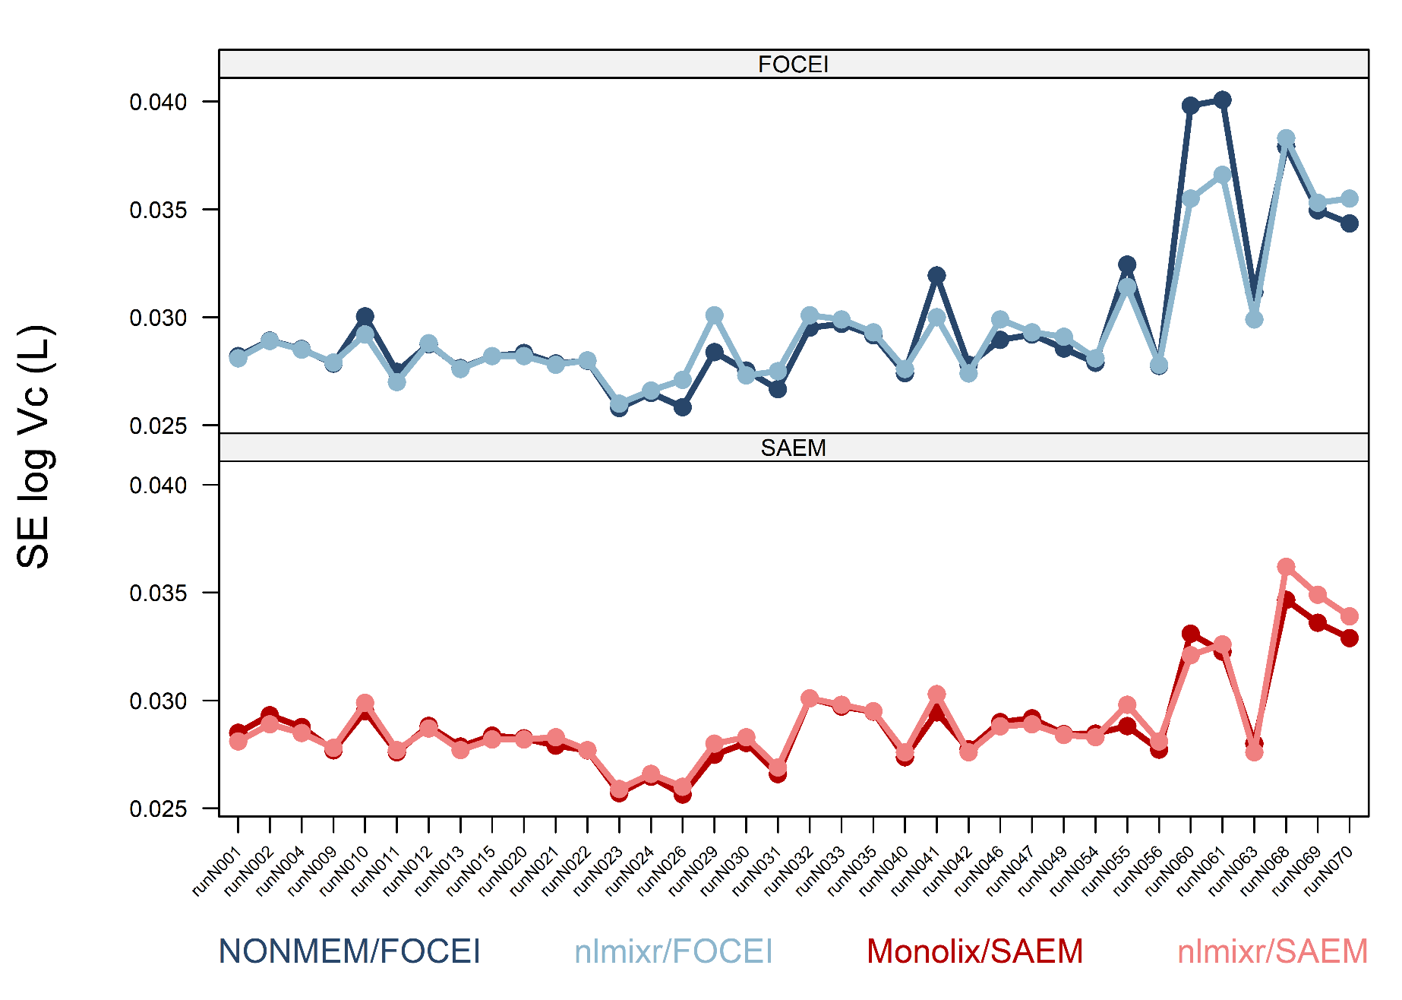
SE of theta estimates for Vc: very good match across software packages Top panel: FOCEI estimates, bottom panel: SAEM estimates Dark lines: NONMEM/MONOLIX, light lines: nlmixr

Slide 30
Defining nlmixr² models
Models are defined using a function containing an initialisation block (ini) and a model definition block (model)
One.comp.KA.solved <- function() { ini({ # Where initial conditions/variables are specified
}) model({ # Where the model is specified
}) }

Slide 31
Defining nlmixr² models
The ini block defines the parameters
Thetas and residual error defined using assign operators (<- or =)
Etas defined using a model formula (~)
Parameter names, starting values, labels for thetas and errors (using #), bounds for some estimation routines (like FOCEI)
One.comp.KA.solved <- function() { ini({ # Where initial conditions/variables are specified lka <- log(1.15) #log ka (1/h) lcl <- log(0.135) #log Cl (L/h) lv <- log(8) #log V (L) prop.err <- 0.15 #proportional error (SD/mean) add.err <- 0.6 #additive error (mg/L) eta.ka ~ 0.5 eta.cl ~ 0.1 eta.v ~ 0.1 }) model({ }) }

Slide 32
Defining nlmixr² models
The model block defines
the relationship between thetas and etas
the model structure using either closed-form solutions or ODEs
the residual error structure, and where it is applied
One.comp.KA.solved <- function() { ini({
}) model({ # Where the model is specified cl <- exp(lcl + eta.cl) v <- exp(lv + eta.v) ka <- exp(lka + eta.ka) ## solved system example ## where residual error is assumed to follow proportional and additive error linCmt() ~ prop(prop.err) + add(add.err) }) }

Slide 33
Running nlmixr² models: the full model
One.comp.KA.solved <- function() { ini({ # Where initial conditions/variables are specified lka <- log(1.15) #log ka (1/h) lcl <- log(0.135) #log Cl (L/h) lv <- log(8) #log V (L) prop.err <- 0.15 #proportional error (SD/mean) add.err <- 0.6 #additive error (mg/L)
eta.ka ~ 0.5 eta.cl ~ 0.1 eta.v ~ 0.1
}) model({ # Where the model is specified cl <- exp(lcl + eta.cl) v <- exp(lv + eta.v) ka <- exp(lka + eta.ka) ## solved system example ## where residual error is assumed to follow proportional and additive error linCmt() ~ prop(prop.err) + add(add.err) }) }

Slide 34
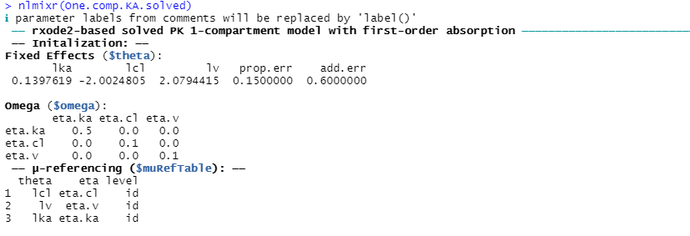
Running nlmixr² models: check the model code
## Check the model and some of the assumptions made by nlmixr
nlmixr(One.comp.KA.solved)

Slide 35
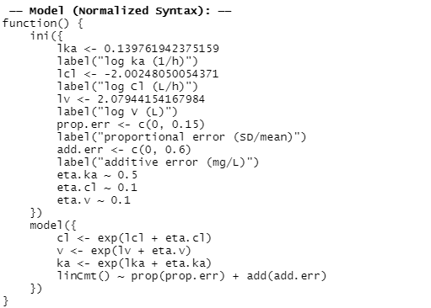
Running nlmixr² models: check the model code
## Check the model and some of the assumptions made by nlmixr
nlmixr(One.comp.KA.solved)

Slide 36
Running nlmixr² models with the nlmixr command
## estimate parameters using nlmixr: fitOne.comp.KA.solved_S <- nlmixr( One.comp.KA.solved, #the model definition PKdata, #the data set est = "saem", #the estimation algorithm (SAEM) #the SAEM minimisation options: saemControl(nBurn = 200, #200 SAEM burn-in iterations (the default) nEm = 300, #300 EM iterations (the default) print = 50), #only print every 50th estimation step tableControl(cwres = TRUE, #calculates NONMEM-style conditional weighted residuals npde = TRUE) # and npde values for diagnostics
) ## results are stored in the nlmixr object and can be viewed: fitOne.comp.KA.solved_S

Slide 37
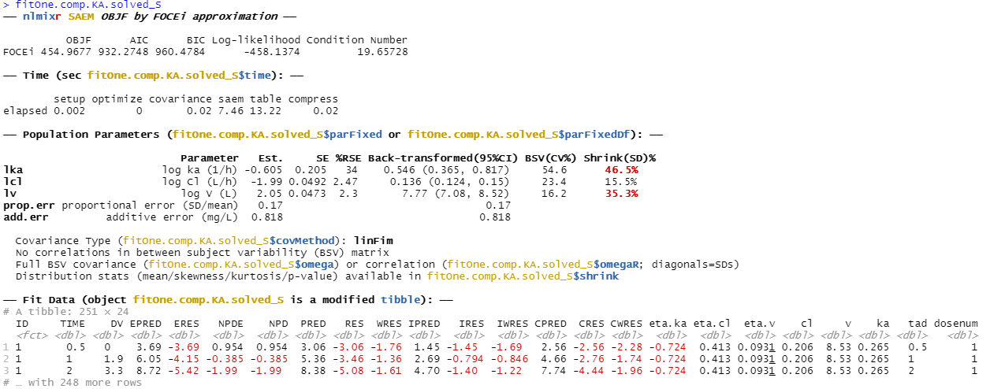
nlmixr² output for SAEM

Slide 38
The labels in the ini block end up in the output, and the log-transformed parameters are returned with a back-transformation and 95%CIs

Slide 39
Running nlmixr² models: save the object, and examine parameter trace plots when using SAEM to check convergence
## results are stored in the nlmixr object and can be viewed: fitOne.comp.KA.solved_S ## and saved for future use or reference: save(fitOne.comp.KA.solved_S, file = "fitOne.comp.KA.solved_S.Rdata") ## and for SAEM, convergence can be checked using a parameter trace plot: traceplot(fitOne.comp.KA.solved_S)

Slide 40
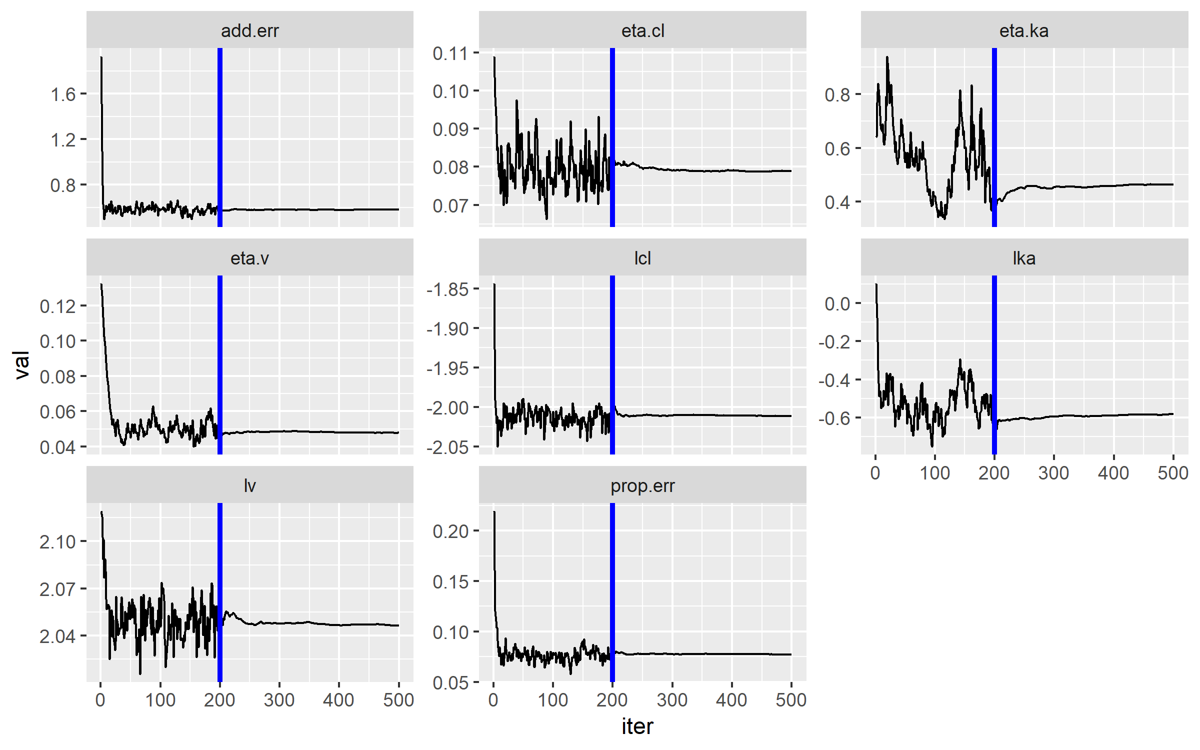
Traceplot for SAEM parameter estimates using traceplot command

Slide 41
nlmixr² is linked to ggPMX
# Model Diagnostics with ggPMX
# The controller is first constructed
ctr <- pmx_nlmixr(fitOne.comp.KA.solved_S,
conts = c("WT","AGE"),
cats=c("SEX","SPARSE"),
vpc=FALSE,
settings=pmx_settings(is.draft=FALSE))
# and can then be piped into a specific plot
# syntax for npde vs pred plot
ctr %>% pmx_plot_npde_pred
#alternatively:
pmx_plot_npde_pred(ctr)

Slide 42
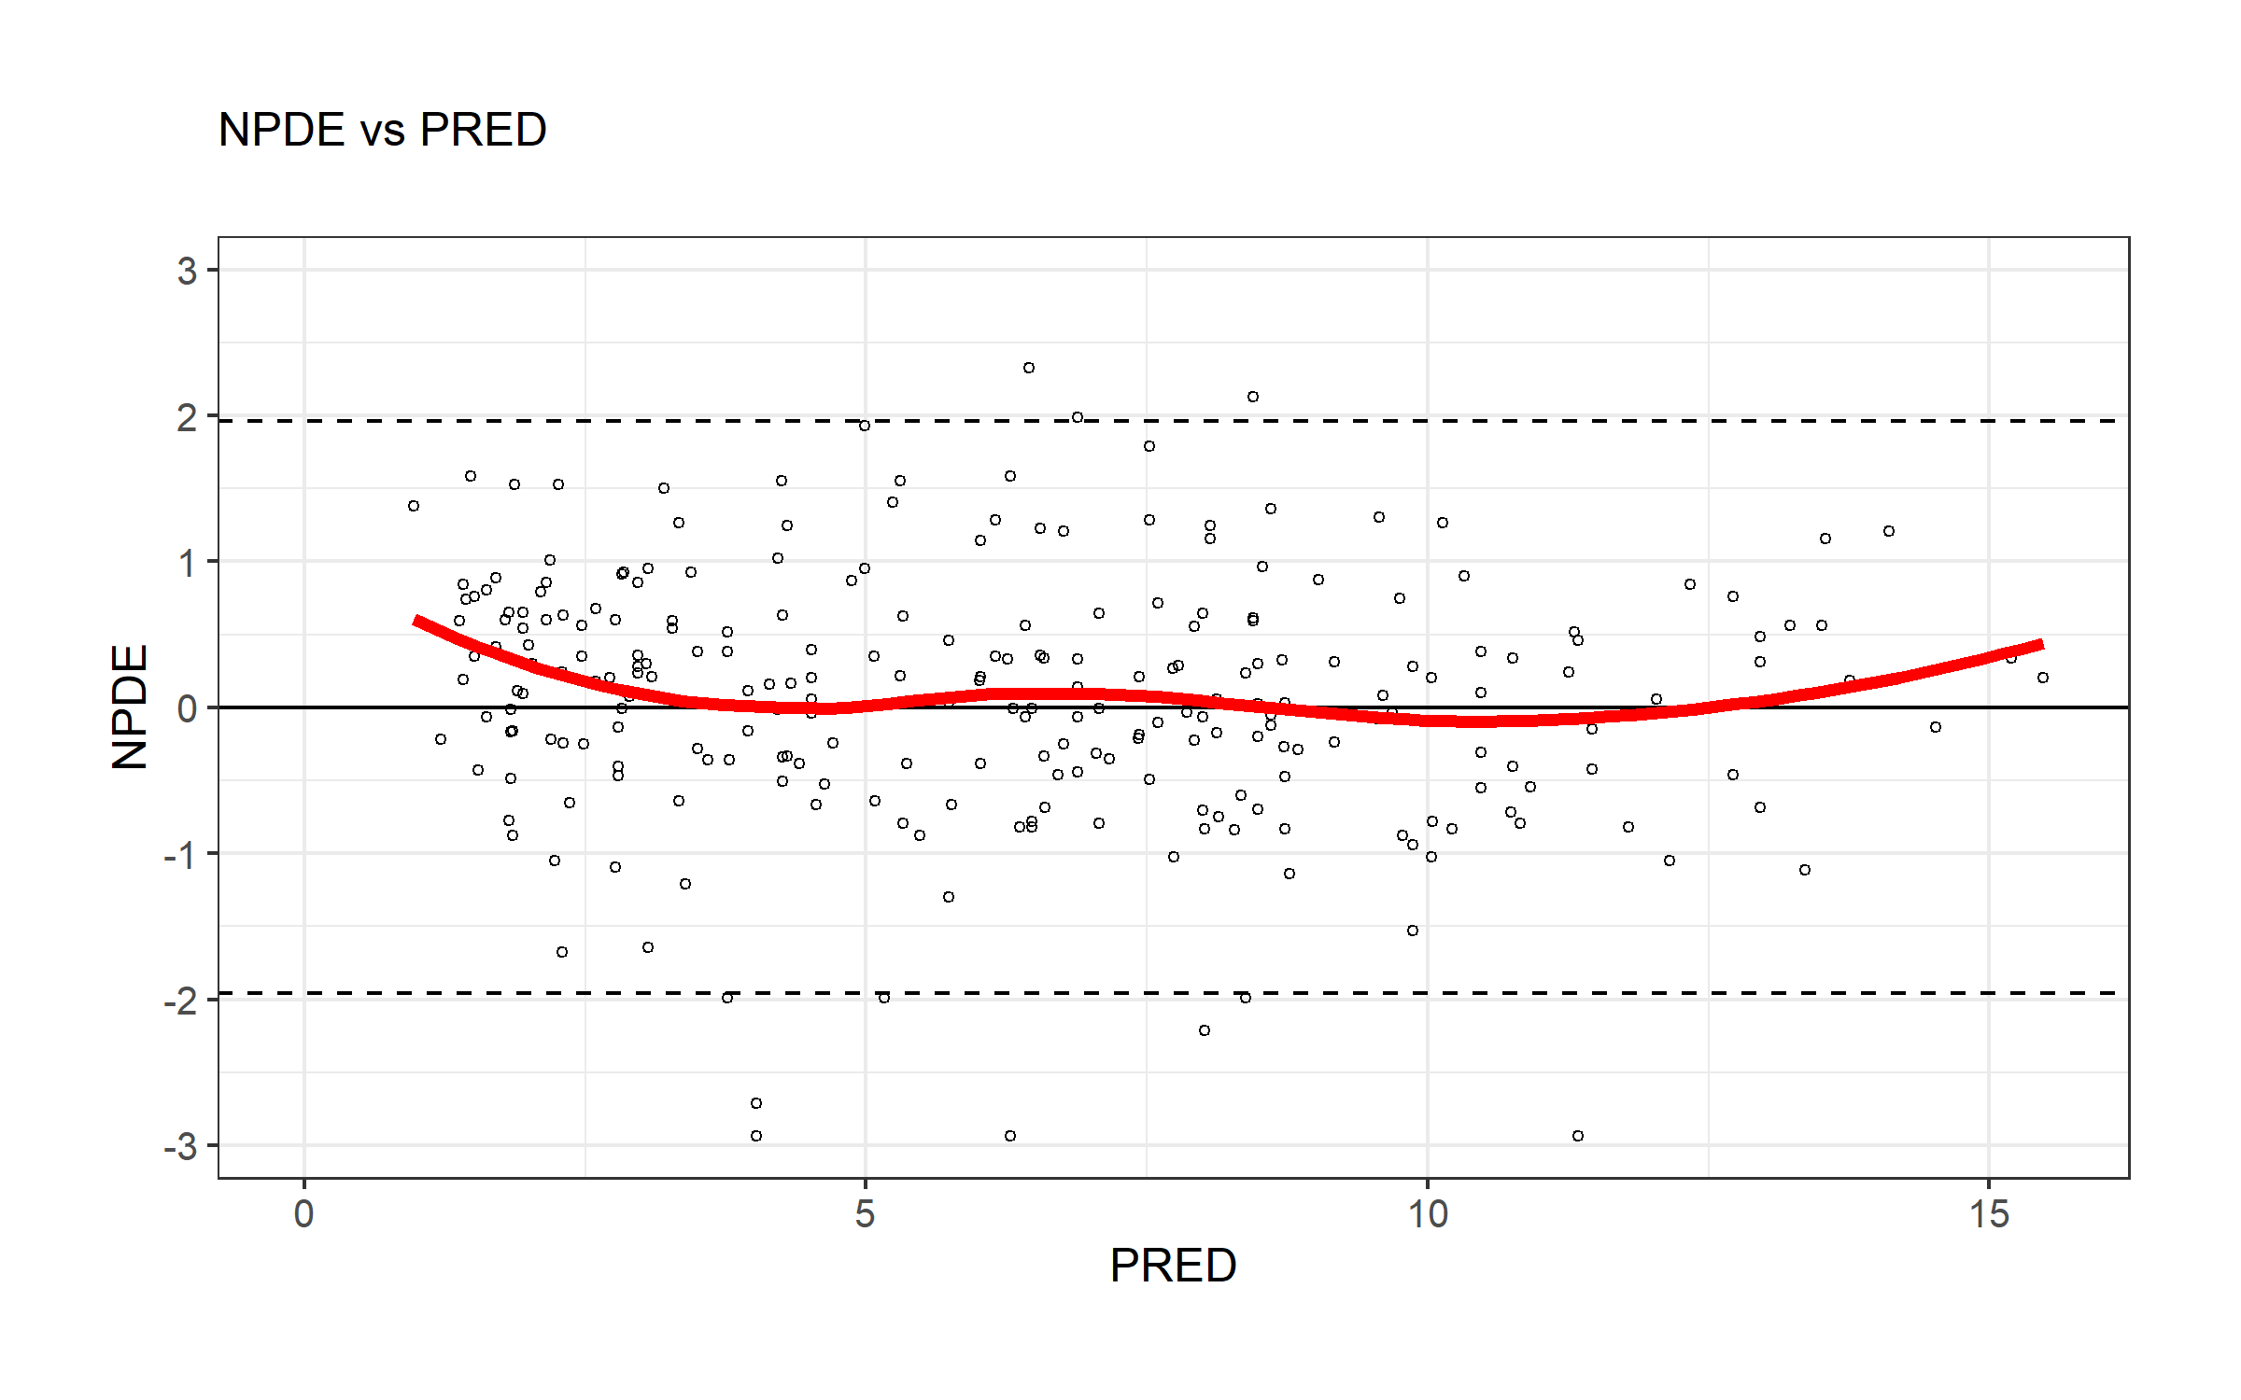
nlmixr² is linked to ggPMX
# Model Diagnostics with ggPMX
# The controller is first constructed
ctr <- pmx_nlmixr(fitOne.comp.KA.solved_S,
conts = c("WT","AGE"),
cats=c("SEX","SPARSE"),
vpc=FALSE,
settings=pmx_settings(is.draft=FALSE))
# and can then be piped into a specific plot
# syntax for npde vs pred plot
ctr %>% pmx_plot_npde_pred
#alternatively:
pmx_plot_npde_pred(ctr)

Slide 43
nlmixr² is linked to ggPMX
## Modify graphical options and add DRAFT label:
ctr %>% pmx_plot_npde_time(smooth = list(color="blue"),
point = list(shape=4),
s.draft=TRUE,
labels = list(x = "Time (hours)",
y = "Normalized PDE"))

Slide 44
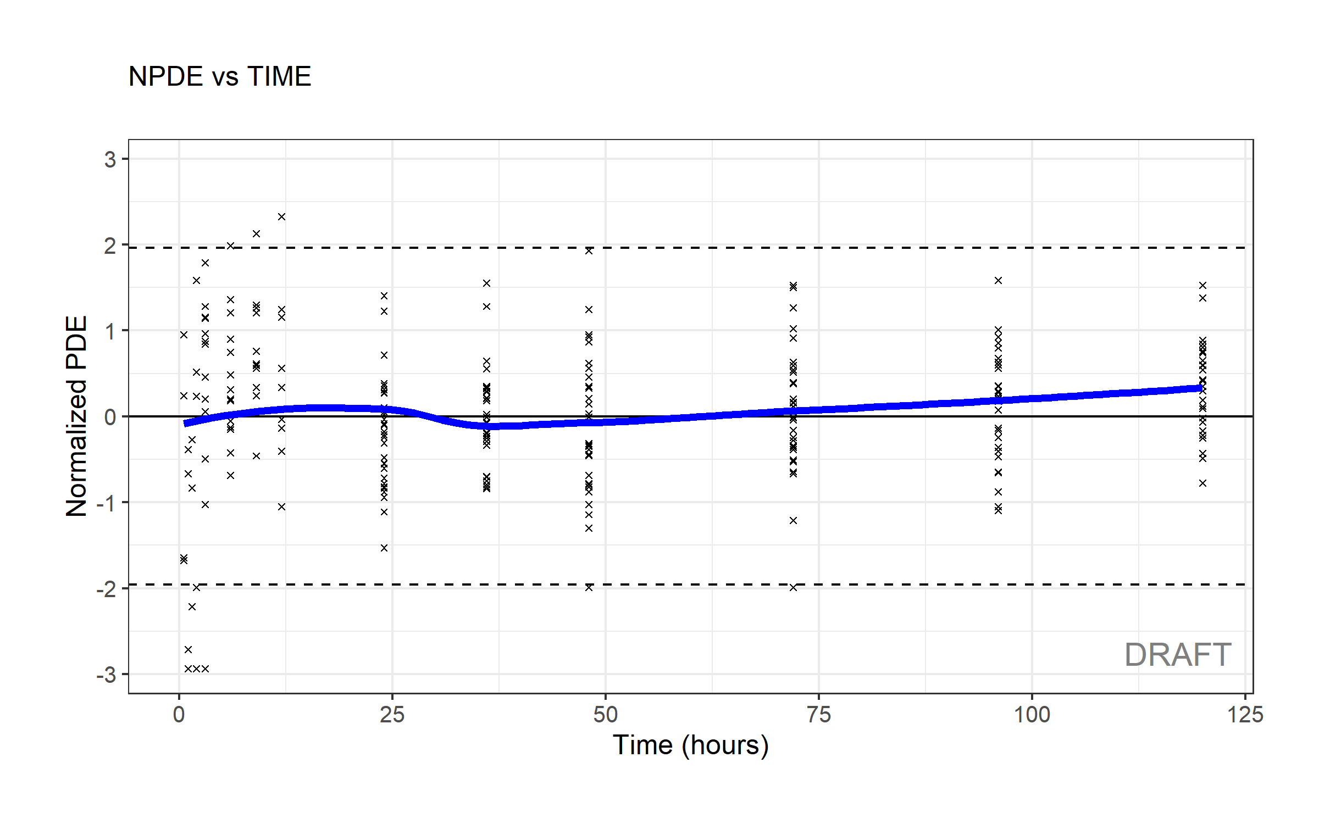
nlmixr² is linked to ggPMX
## Modify graphical options and add DRAFT label:
ctr %>% pmx_plot_npde_time(smooth = list(color="blue"),
point = list(shape=4),
s.draft=TRUE,
labels = list(x = "Time (hours)",
y = "Normalized PDE"))

Slide 45
nlmixr² is linked to ggPMX
## DV vs IPRED plot
ctr %>% pmx_plot_dv_ipred(scale_x_log10=TRUE, scale_y_log10=TRUE)
#You can filter to restrict the values of IPRED for instance:
ctr %>% pmx_plot_dv_ipred(scale_x_log10=TRUE, scale_y_log10=TRUE,filter=(IPRED>1))
## DV vs PRED plot
ctr %>% pmx_plot_dv_pred(scale_x_log10=TRUE, scale_y_log10=TRUE)
## Absolute individual weighted residuals to investigate the residual error model
ctr %>% pmx_plot_abs_iwres_ipred
#again, alternatively:
#pmx_plot_abs_iwres_ipred(ctr)
ctr %>% pmx_plot_iwres_dens
ctr %>% pmx_plot_eta_qq
ctr %>% pmx_plot_eta_box
ctr %>% pmx_plot_eta_hist
ctr %>% pmx_plot_eta_matrix

Slide 46
nlmixr² is linked to ggPMX
## generate a full report with diagnostics
ctr %>% pmx_report(name="ggPMX_report",
save_dir=".",
format="report",
extension="word")

Slide 47
nlmixr² is linked to Ben Guiastrennec's xpose* package that uses ggplot2
*https://uupharmacometrics.github.io/xpose/
## the nlmixr object can be transformed into an xpose object to allow diagnostics with the new xpose package ## the link between nlmixr and xpose is provided by the xpose.nlmixr package ## only xpose_data_nlmixr is from xpose.nlmixr
## all further commands (see cheatsheet) are from the xpose package
xpdb.1s <- xpose_data_nlmixr(fitOne.comp.KA.solved_S) ## this can also be used to generate trace plots (parameters vs iterations:) prm_vs_iteration(xpdb.1s) ## to remove the path to the script from the plot use: prm_vs_iteration(xpdb.1s,caption=NULL)

Slide 48
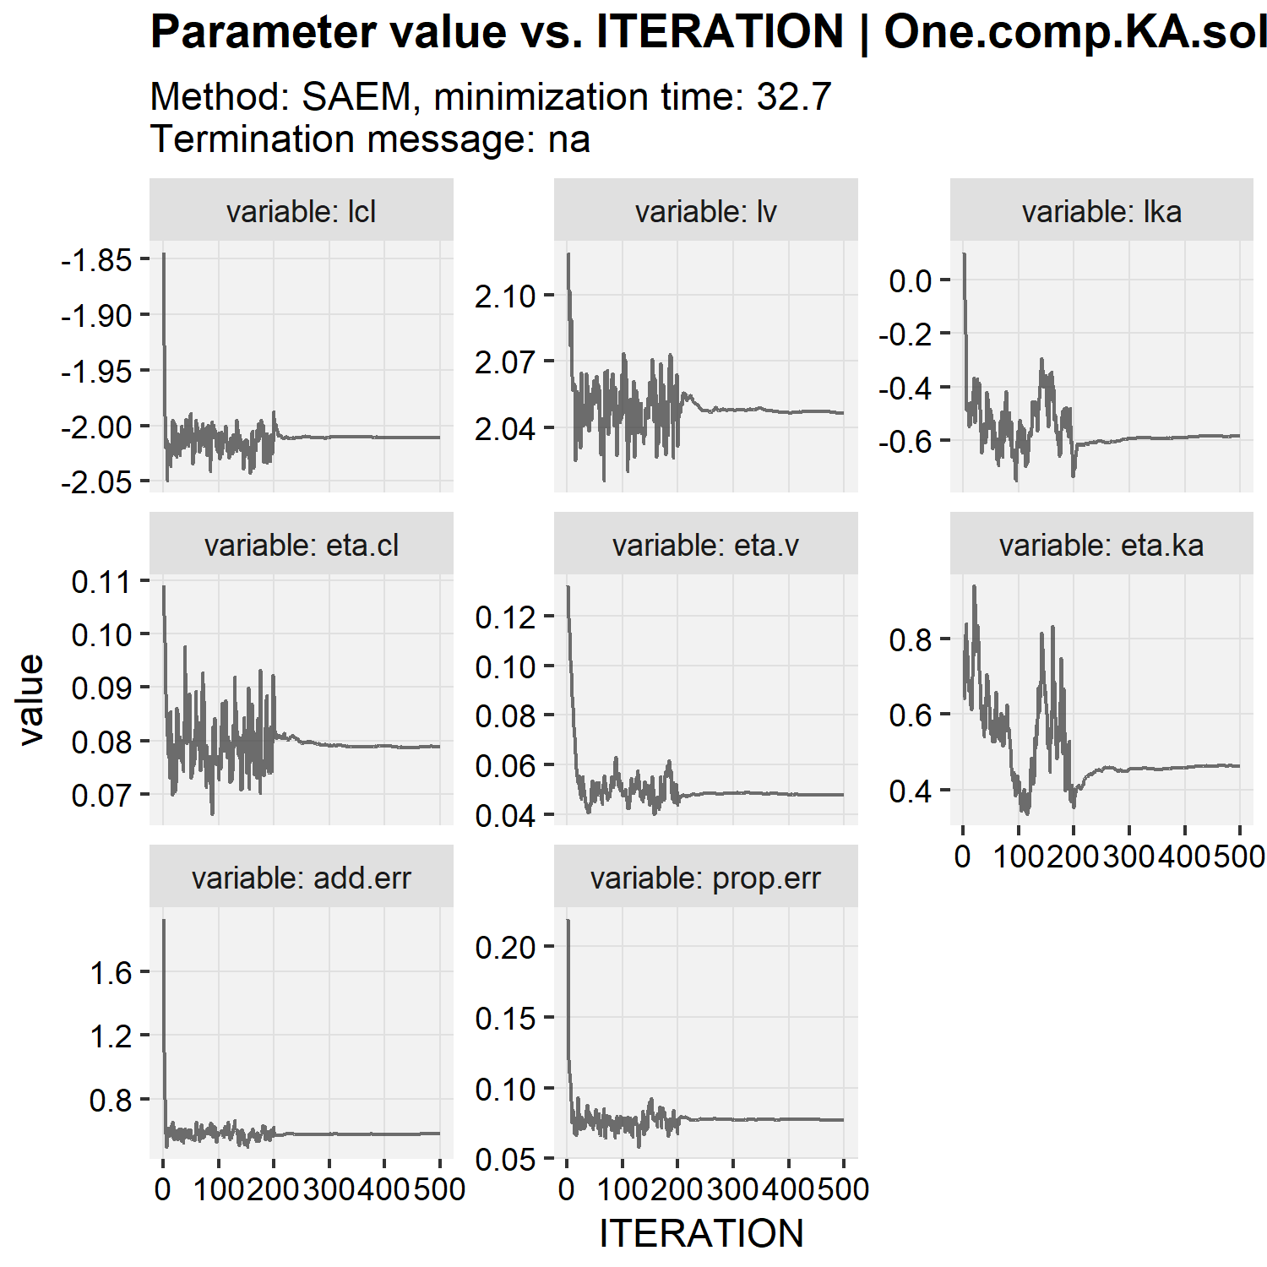
Traceplot for SAEM parameter estimates using xpose

Slide 49
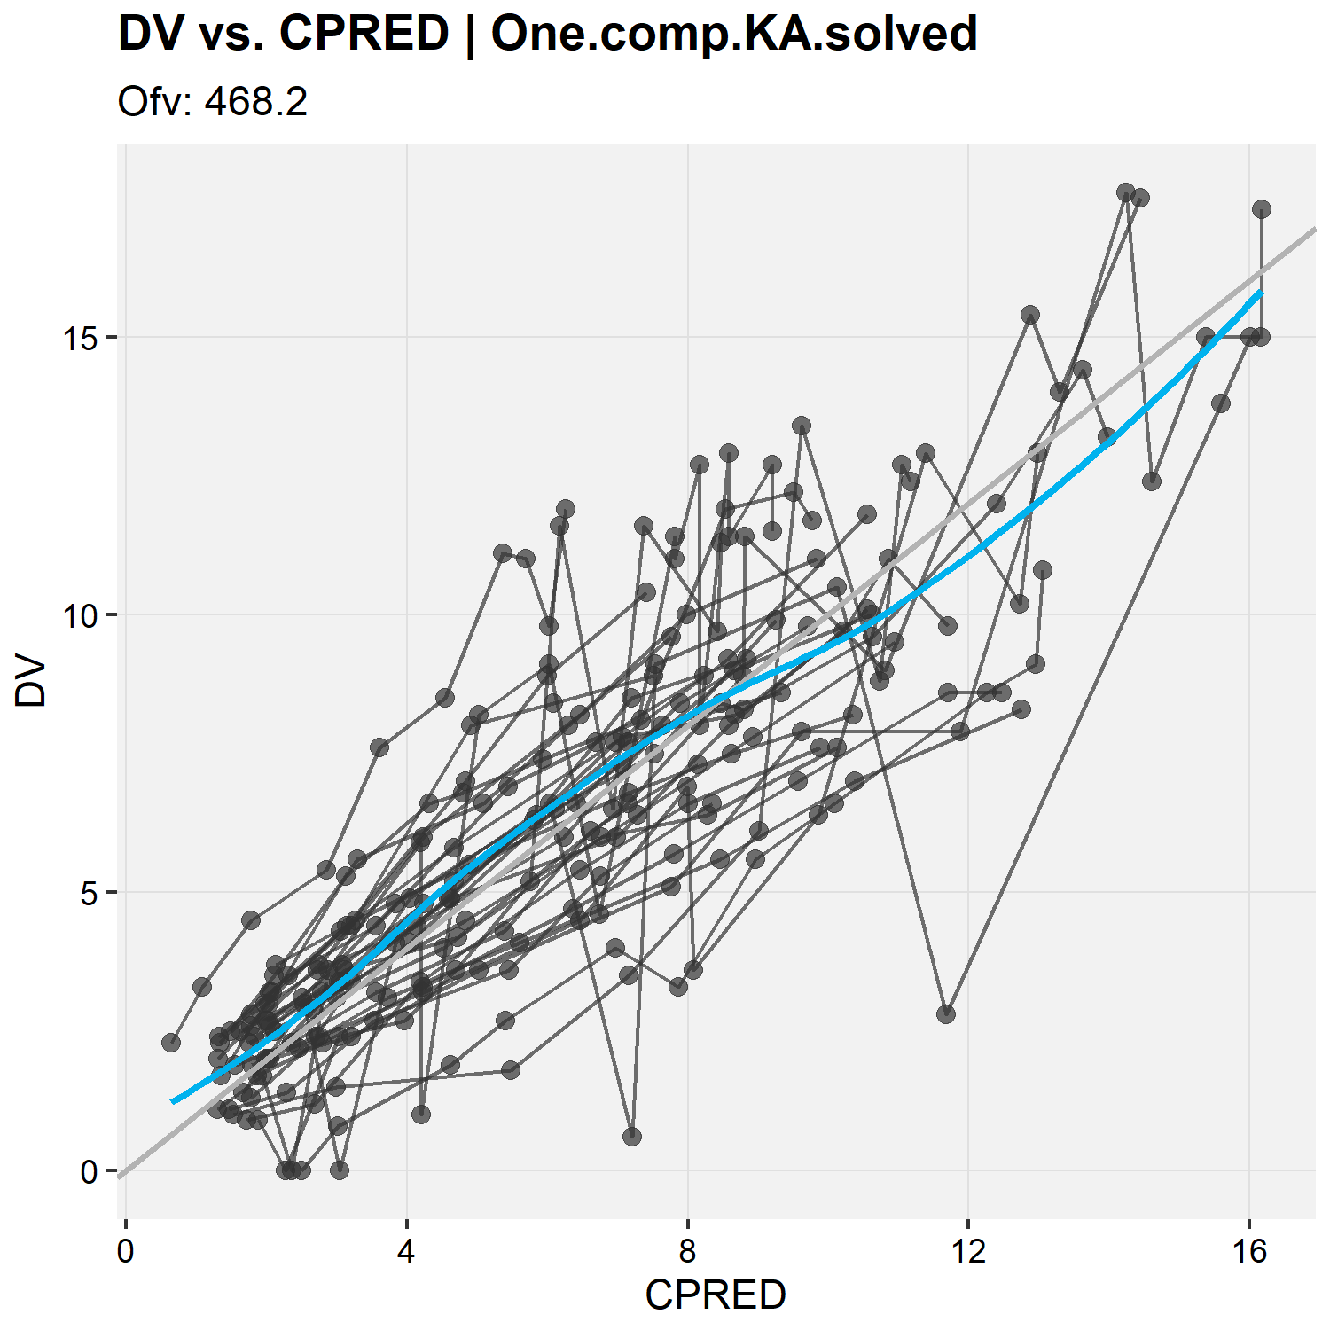
DV vs conditional population predictions (CPRED) using xpose
xpdb.1s <- xpose_data_nlmixr(fitOne.comp.KA.solved_S) ## dv vs pred plot: dv_vs_pred(xpdb.1s, caption = NULL)

Slide 50
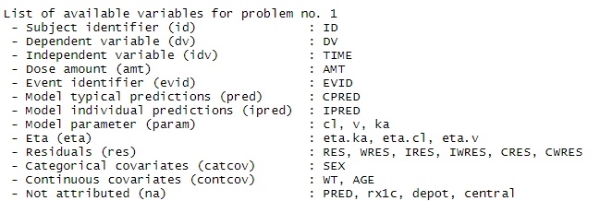
DV vs PRED using xpose
# by default model typical predictions (PRED) are assigned to CPRED (conditional population predictions): list_vars(xpdb.1s)
# if you want this to be PRED instead, these can be updated, either using 'standard' syntax: xpdb.1s<-set_var_types(xpdb.1s,pred = 'PRED') # or using magrittr piping type code: xpdb.1s<-xpdb.1s %>% set_var_types(pred = 'PRED')

Slide 51
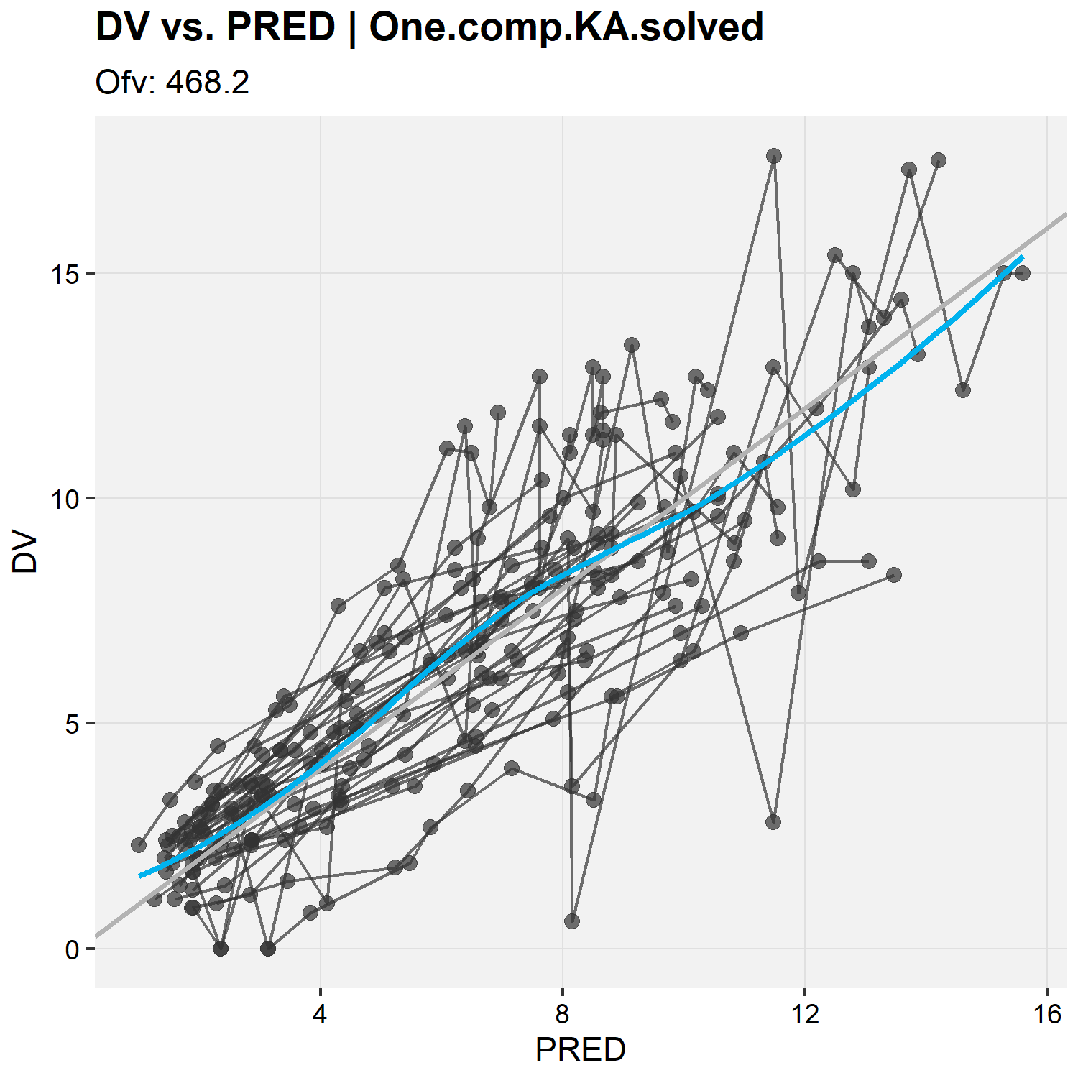
DV vs PRED using xpose
xpdb.1s <- xpose_data_nlmixr(fitOne.comp.KA.solved_S)
## plot PRED instead of CPRED: xpdb.1s<-xpdb.1s %>% set_var_types(pred = 'PRED') ## dv vs pred plot: dv_vs_pred(xpdb.1s, caption = NULL)

Slide 52
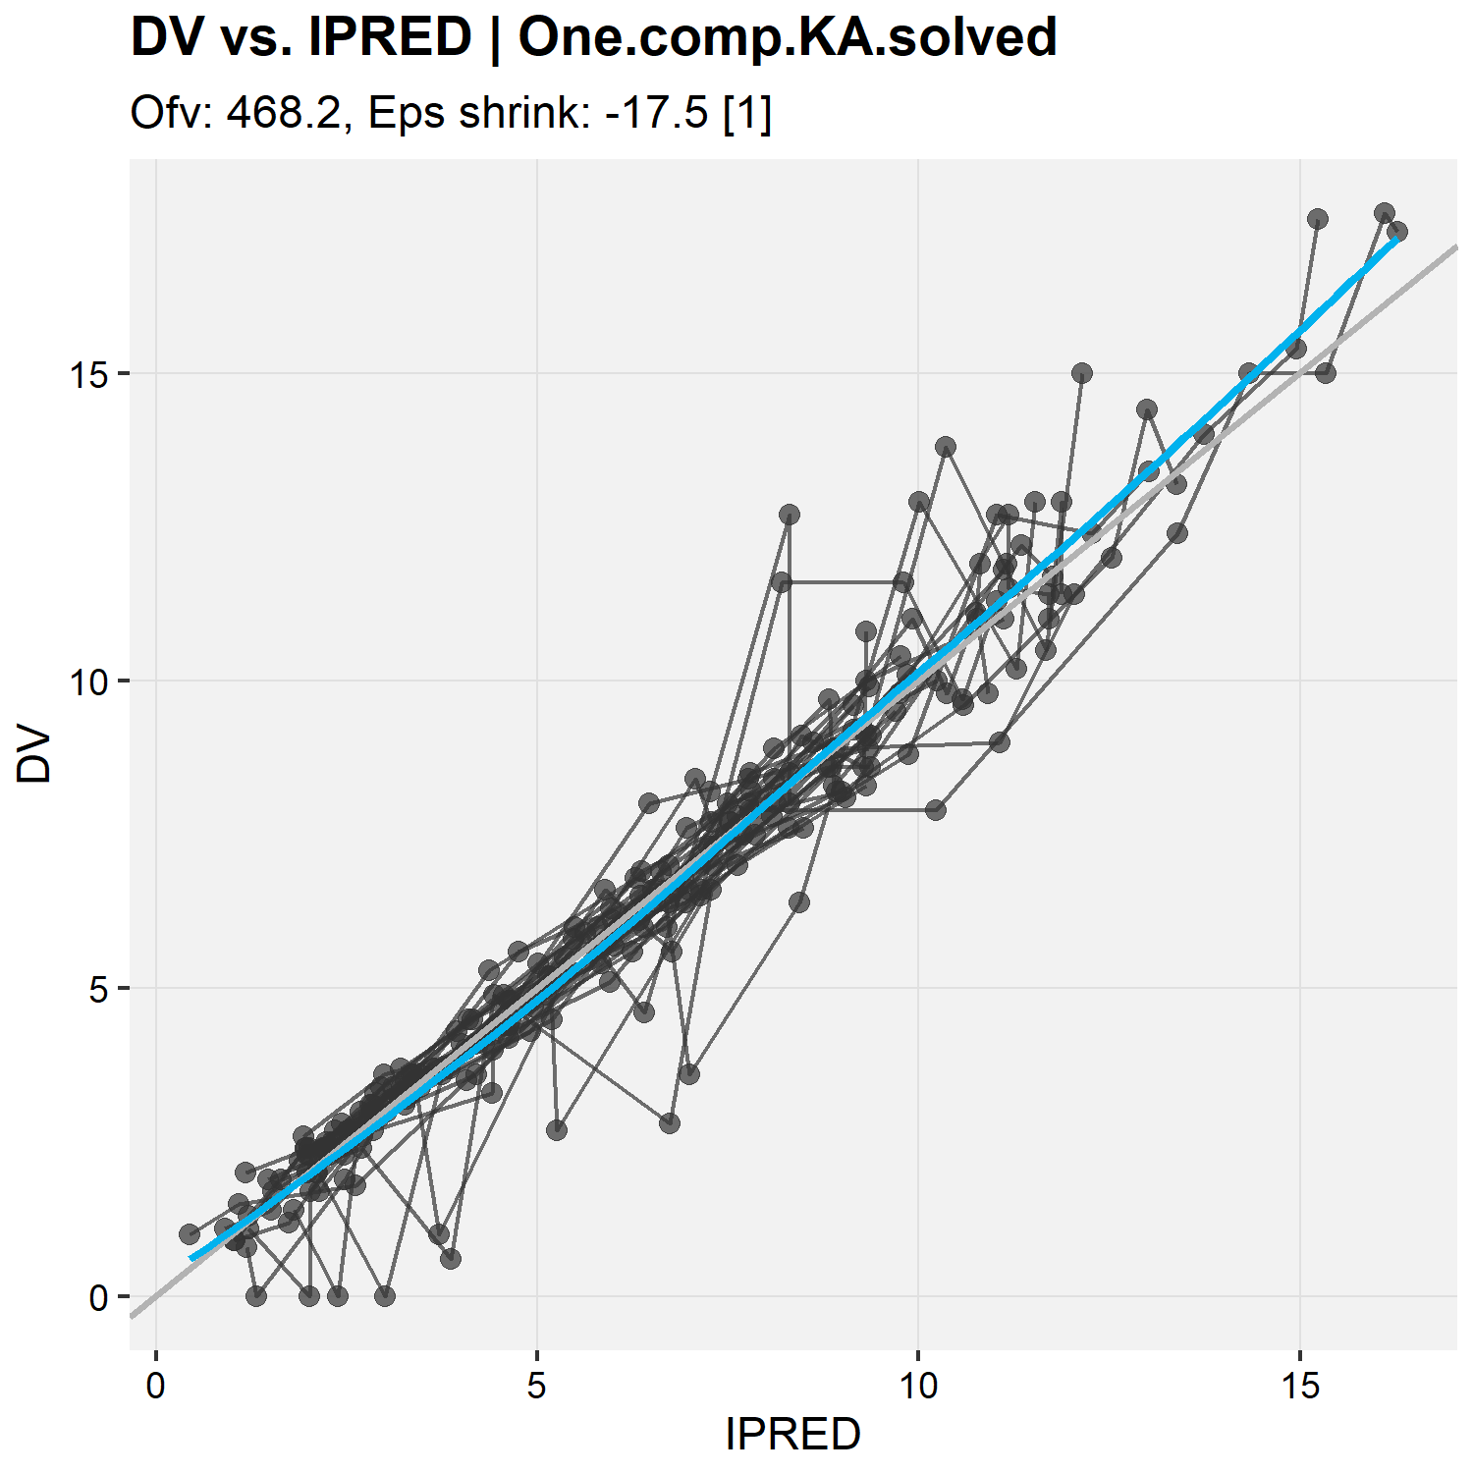
DV vs IPRED using xpose
xpdb.1s <- xpose_data_nlmixr(fitOne.comp.KA.solved_F) ## dv vs ipred plot: dv_vs_ipred(xpdb.1s, caption = NULL)

Slide 53
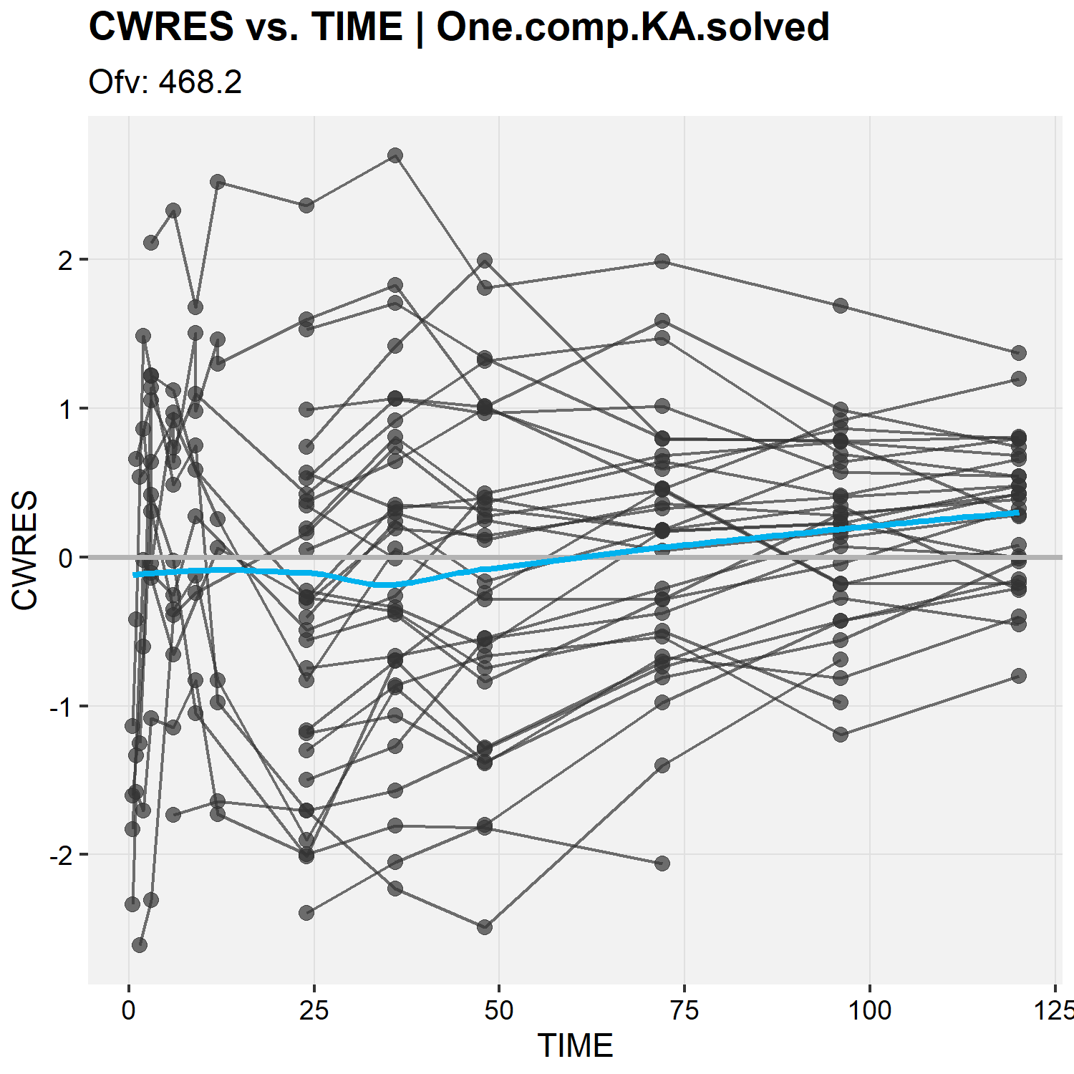
Conditional weighted residuals vs. time using xpose
xpdb.1s <- xpose_data_nlmixr(fitOne.comp.KA.solved_S) ## CWRES vs time: res_vs_idv(xpdb.1s, #the xpose object res = "CWRES", #examine CWRES idv = "TIME", #as a function of time caption = NULL)

Slide 54
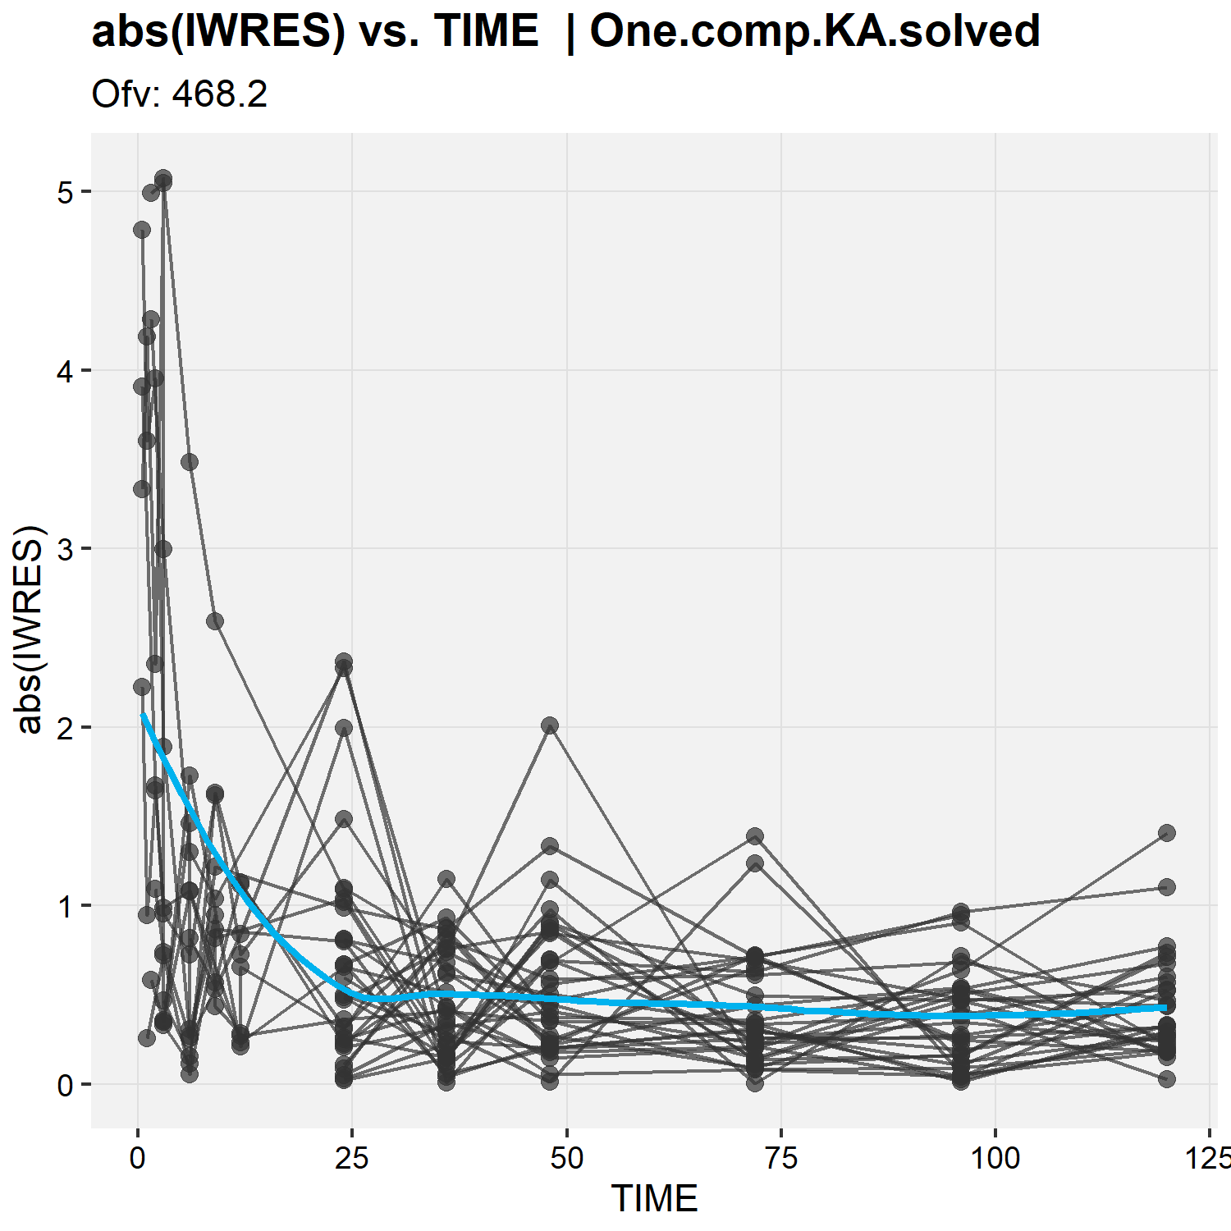
Absolute values of individual weighted residuals vs. time
xpdb.1s <- xpose_data_nlmixr(fitOne.comp.KA.solved_S) ## |IWRES| vs time: absval_es_vs_idv(xpdb.1s, #the xpose object res = "IWRES", #examine |IWRES| idv = "TIME", #as a function of time caption = NULL)
## Issue with absorption?

Slide 55
nlmixr² is linked to Ron Keizer's vpc* package
*http://vpc.ronkeizer.com/
## nlmixr comes with its own built-in vpc functionality that uses Ron Keizer's vpc package ## see the cheatsheet for further options
## because the data set uses nominal time points, it is nice to have the bins surround these time points ## so that each time point falls in a bin
bin_mids <- sort(unique(PKdata$TIME))
bin_edges <- bin_mids - c(0, diff(bin_mids) / 2) vpcPlot( fitOne.comp.KA.solved_S, #the nlmixr object n = 500, #number of trials simulated
bins = bin_edges, show = list(obs_dv = TRUE, #additional items to show, like the observations
obs_median = TRUE,
sim_median = TRUE,
sim_median_ci = TRUE,
obs_ci = TRUE,
pi = TRUE
), xlab = "Time (h)", #x-axis label ylab = "Concentration (mg/L)", #y-axis label title = "VPC for first order absorption PopPK model" )

Slide 56
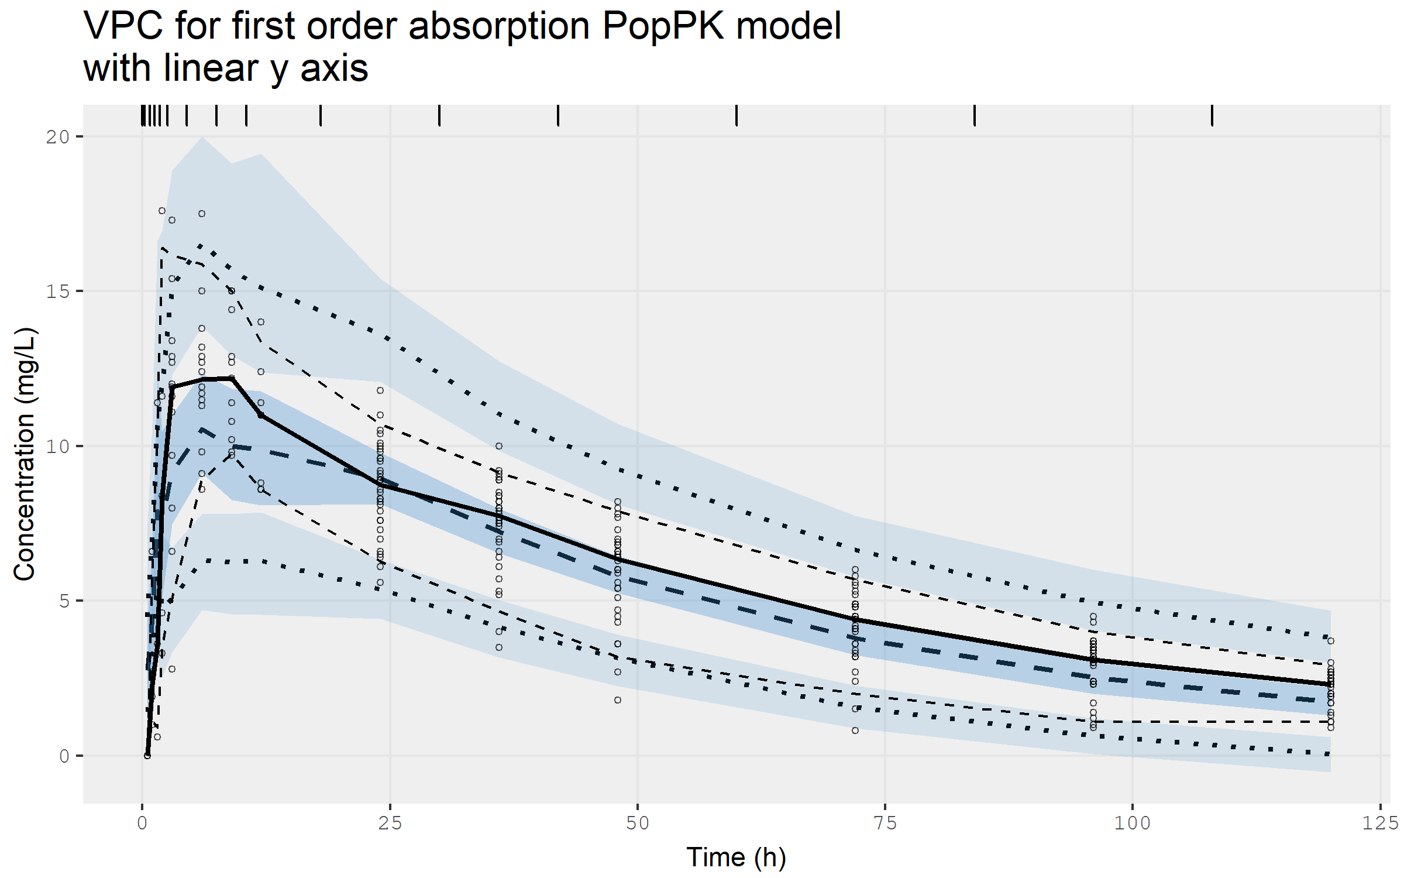
VPC for the base model on linear scale...

Slide 57
...and on log scale
## or with a log y-axis starting at 0.5 vpcPlot( fitOne.comp.KA.solved_S, #the nlmixr object n = 500, #number of trials simulated
bins = bin_edges, show = list(obs_dv = TRUE, #additional items to show, like the observations
obs_median = TRUE,
sim_median = TRUE,
sim_median_ci = TRUE,
obs_ci = TRUE,
pi = TRUE
), xlab = "Time (h)", #x-axis label ylab = "Concentration (mg/L)", #y-axis label title = "VPC for first order absorption PopPK model"
log_y = TRUE, #to request a log y-axis log_y_min = 0.5 #starting at 0.5 )

Slide 58
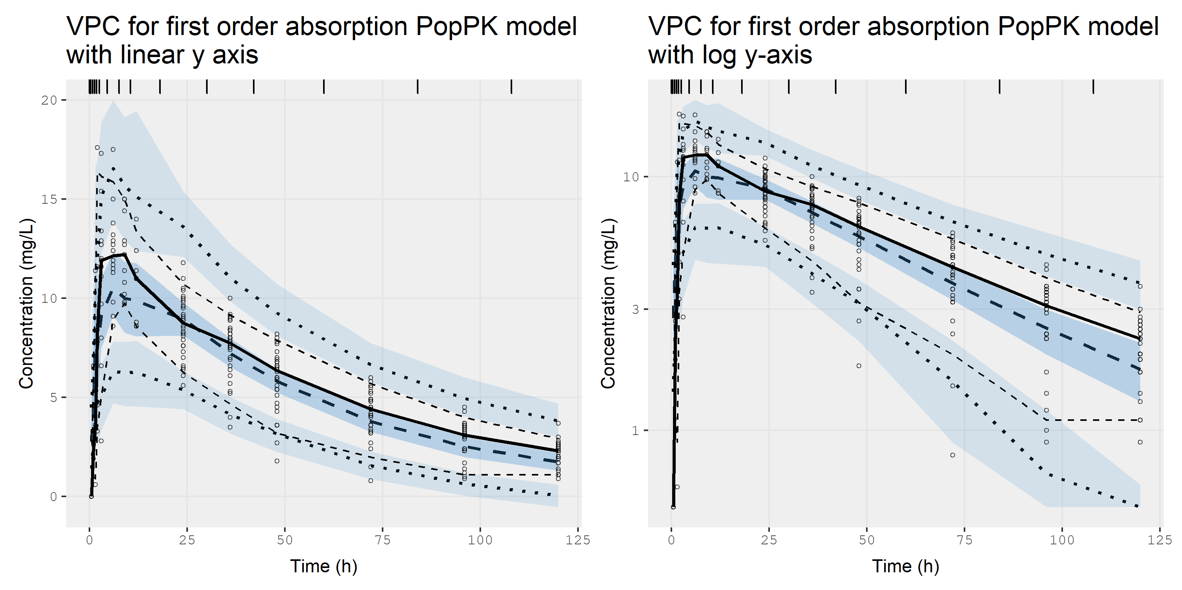
...and on log scale. It's super fast ☺

Slide 59
nlmixr² can generate individual graphs using xpose or augPred
## Individual fits can be generated using using xpose: ind_plots(xpdb.1s,caption = NULL,ncol = 4,nrow = 4) ## ...use the arrows in the plot window to examine the earlier curves ## Individual fits can also be generated using augPred (augmented predictions) ## that provides smooth profiles by interpolating the predictions between observations: plot(augPred(fitOne.comp.KA.solved_S)) ## ...use the arrows in the plot window to examine the earlier curves

Slide 60
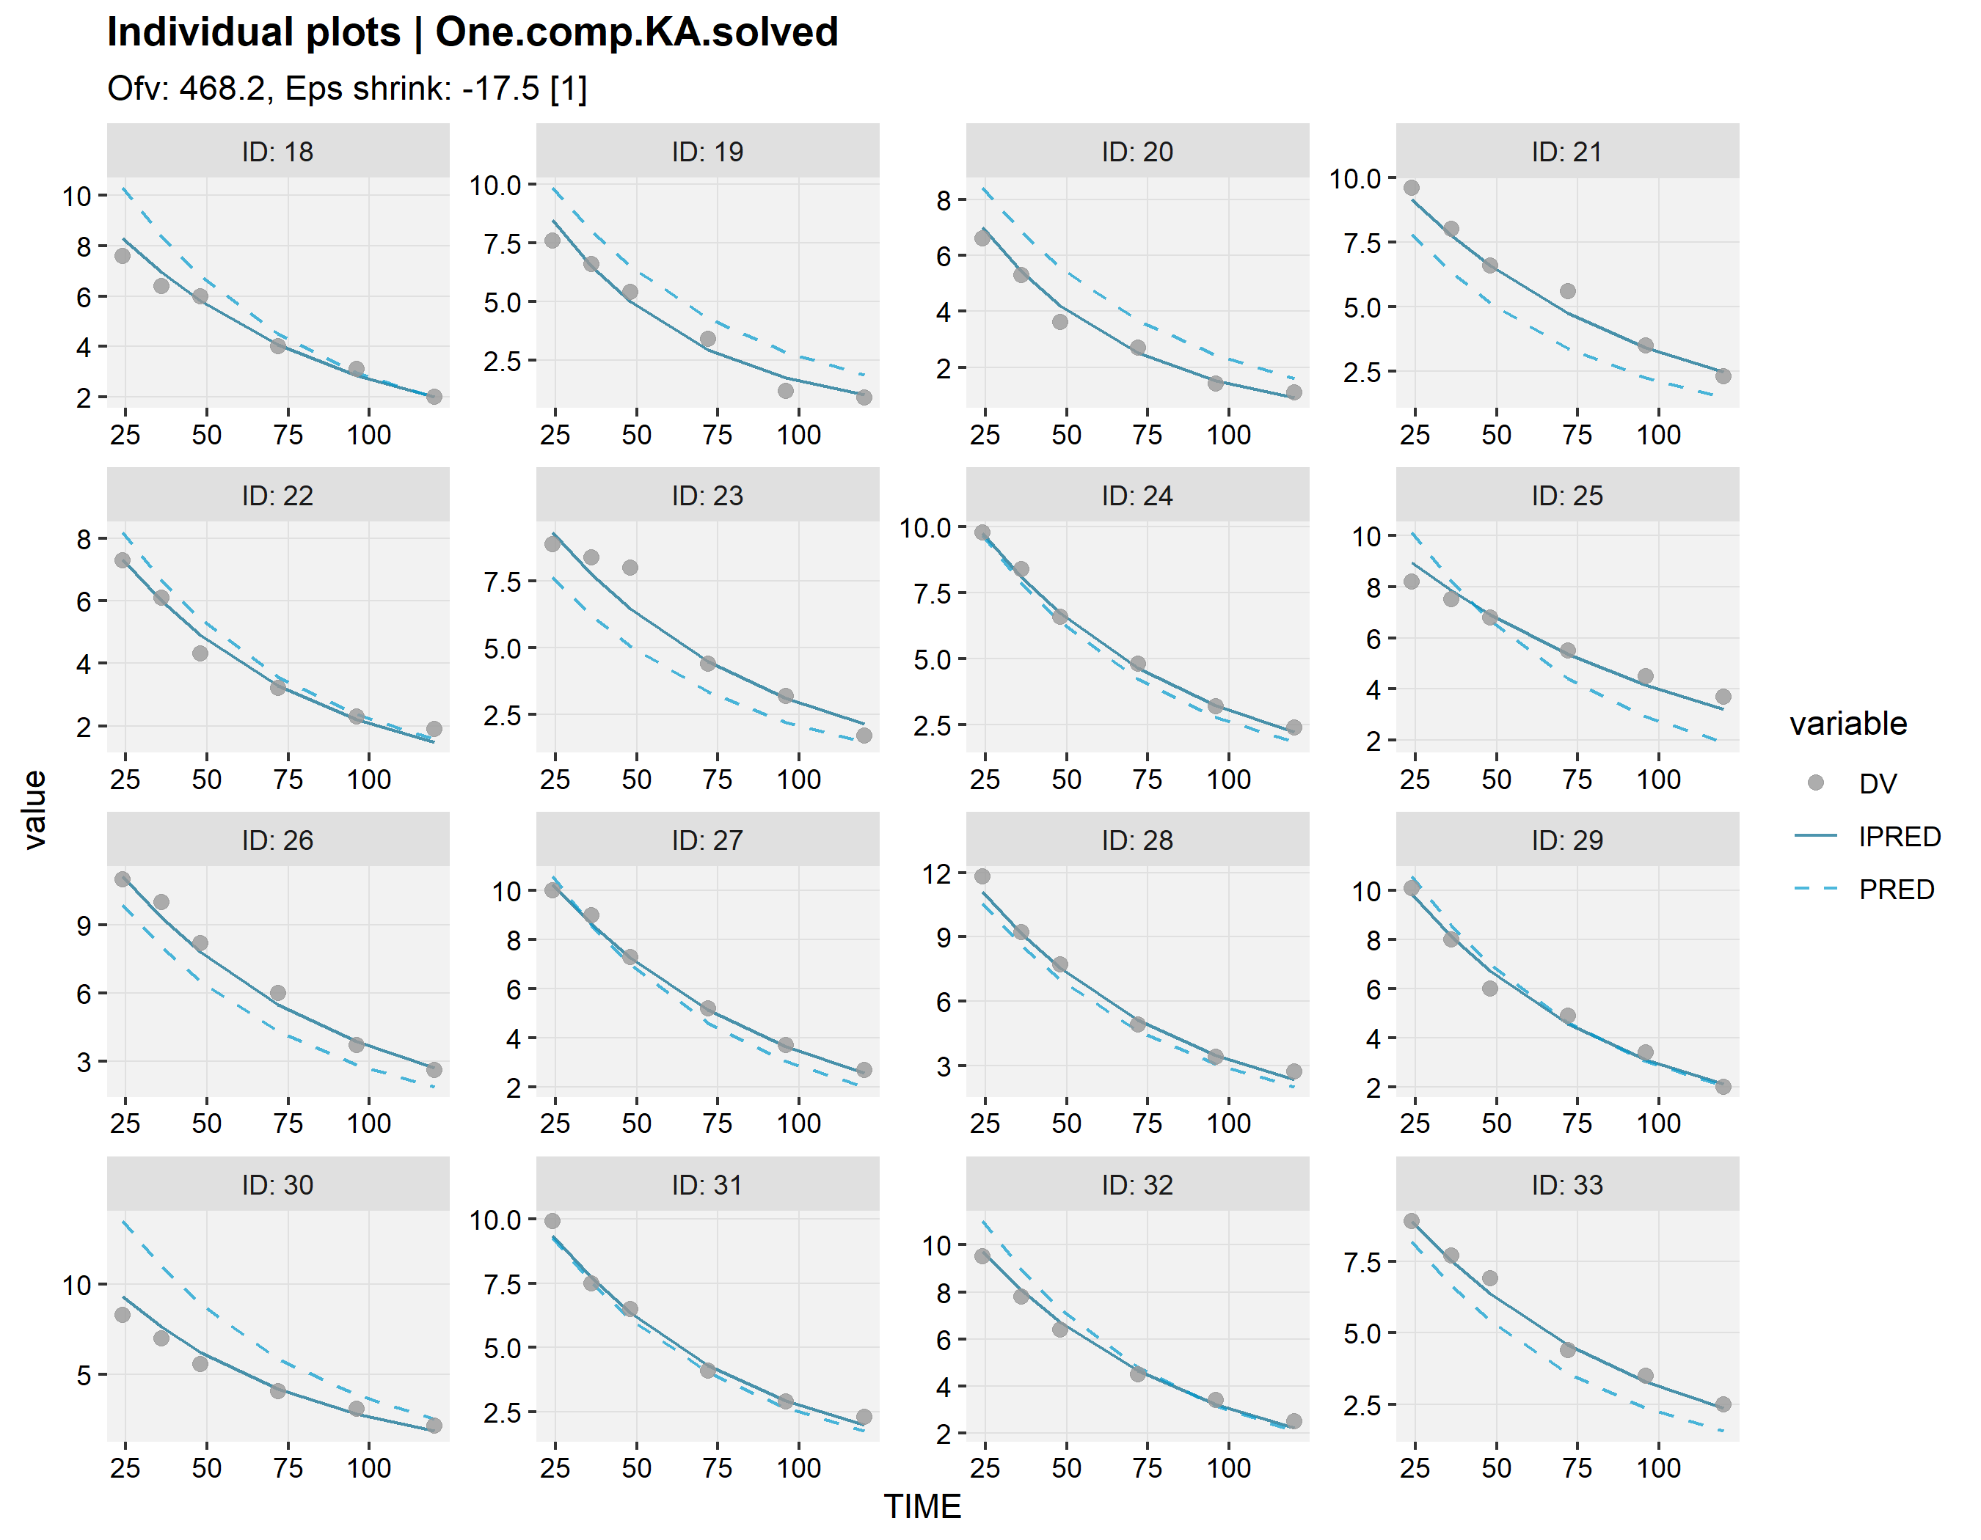
Individual fits can be generated using xpose

Slide 61
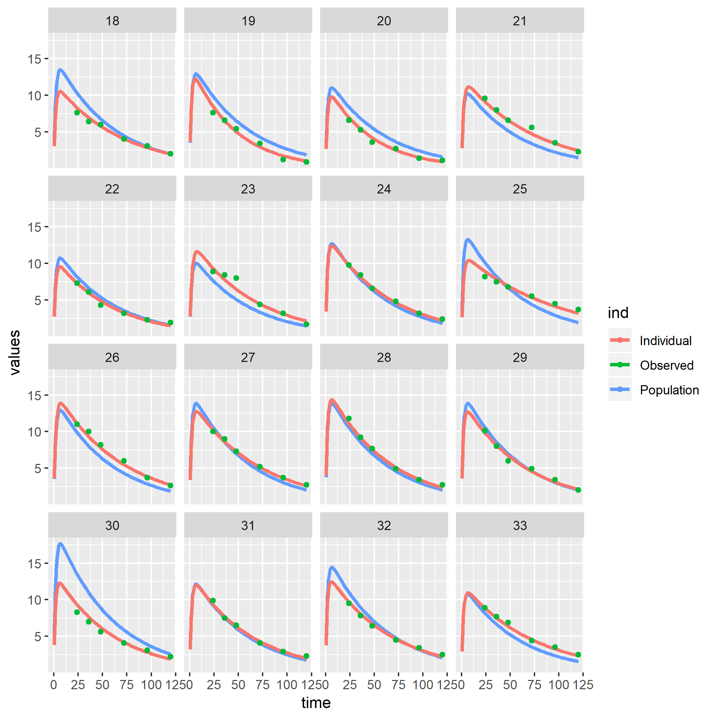
Individual fits can also be generated using augPred (augmented predictions) that provides smooth profiles by interpolating the predictions between observations

Slide 62
use augPred output to plot using your favourite package…
#or the augPred output can be plotted to your liking, for instance using ggplot2 or the lattice function xyplot: indivpk<-augPred(fitOne.comp.KA.solved_S) nlmixCOLS <- c("#28466A","#8DB6CD","#B40000) ## specify array of colours for curves xyplot( values~time|id, ## plot the variable values by time and make a separate panel for each id data=indivpk, ## data source with smooth interpolated predictions and observations groups=ind, ## make separate curves by ind that separates Observed data,
## Individual predictions and Population predictions layout=c(8,4), ## arrange as 8 columns and 4 rows type=c("l","l","p"), ## represent these three by a line, a line and only markers (l=line, p=points) col=nlmixCOLS[c(2,1,3)], ## colours for each curve cex=c(0.1,0.1,1), ## character size for the markers lwd=c(2,2,0.1), ## line width of the lines pch=19, ## use closed circles as marker xlab="Time (hr)\n", ## x-axis label ylab="Warfarin (mg/L)", ## y-axis label as.table=TRUE, ## have the first plot at the top left (otherwise plot 1 starts at the lower left corner) scales=list(alternating=1), ## have axis labels at left and bottom (and not alternating) main="First order-absorption linear elimination", ## title for plot auto.key=list(adj=1,col=nlmixCOLS[c(2,1,3)],columns=3,space="bottom",rectangles=FALSE,points=FALSE) ## key for curves )

Slide 63
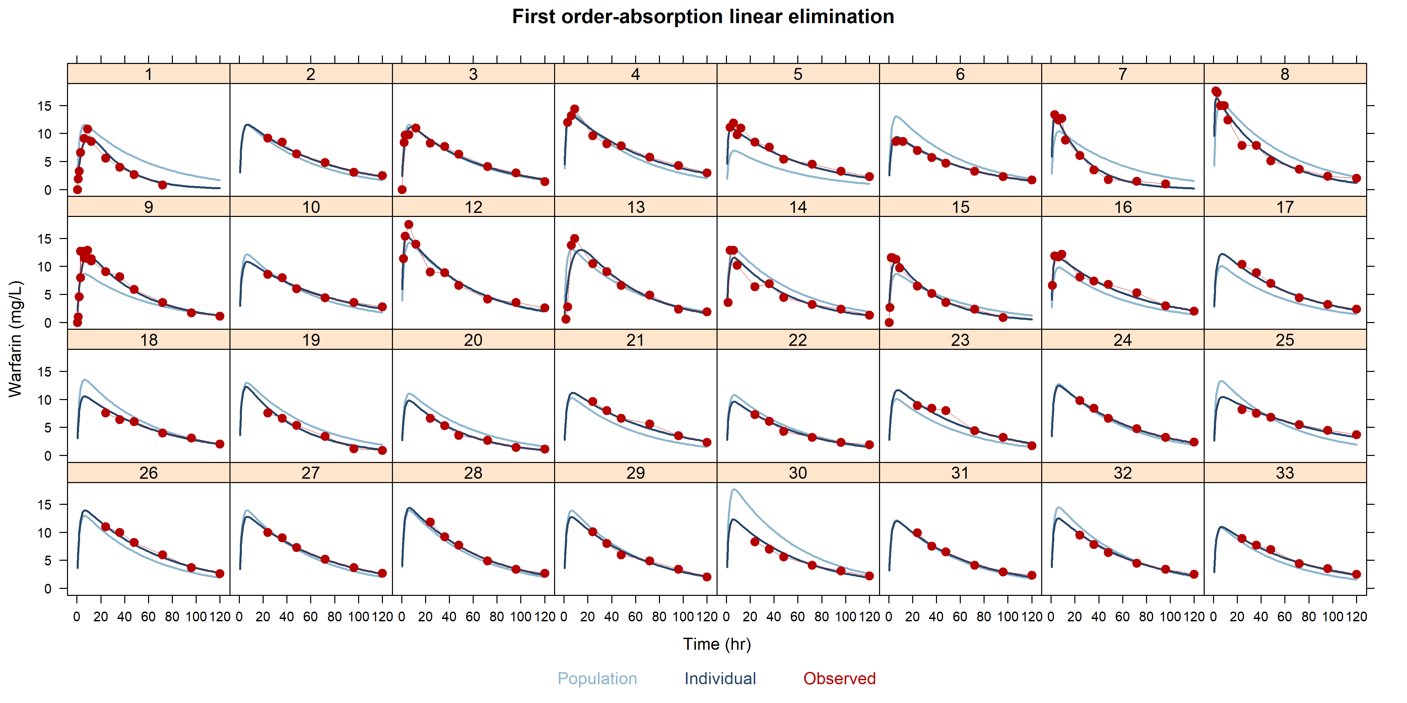
..like lattice

Slide 64
Hands-on session II: running nlmixr² and diagnostics
Examine the code in PAGE_2.R to run a pre-programmed FOCEi analysis with a solved system and its diagnostics
Stop at nlmixr analysis Part 2

Slide 65
Solved systems and ODEs…
Using solved-system code:
For a solved system, model structure is automatically derived (!) from the parameter names in the ini block
Using ODEs:
ODEs are much more flexible but also more time-consuming
linCmt() ~ prop(prop.err) + add(add.err)
# RxODE-style differential equation definition d/dt(gut) = -ka * gut d/dt(central) = ka * gut - (cl / v) * central ## Concentration is calculated cp = central / v # And is assumed to follow proportional and additive error cp ~ prop(prop.err) + add(add.err)

Slide 66
Running nlmixr² for a system of ODEs using FOCEI
One.comp.KA.ODE <- function() { ini({ # Where initial conditions/variables are specified lka <- log(1.15) #log ka (/h) lcl <- log(0.135) #log Cl (L/hr) lv <- log(8) #log V (L) prop.err <- 0.15 #proportional error (SD/mean) add.err <- 0.6 #additive error (mg/L) eta.ka ~ 0.5 eta.cl ~ 0.1 eta.v ~ 0.1 }) model({ # Where the model is specified cl <- exp(lcl + eta.cl) v <- exp(lv + eta.v) ka <- exp(lka + eta.ka) # RxODE-style differential equation definition d/dt(gut) = -ka * gut d/dt(center) = ka * gut - (cl / v) * center ## Concentration is calculated cp = center / v ## And is assumed to follow proportional and additive error cp ~ prop(prop.err) + add(add.err) }) } fitOne.comp.KA.ODE_F <- nlmixr(One.comp.KA.ODE, PKdata, est = "focei")

Slide 67
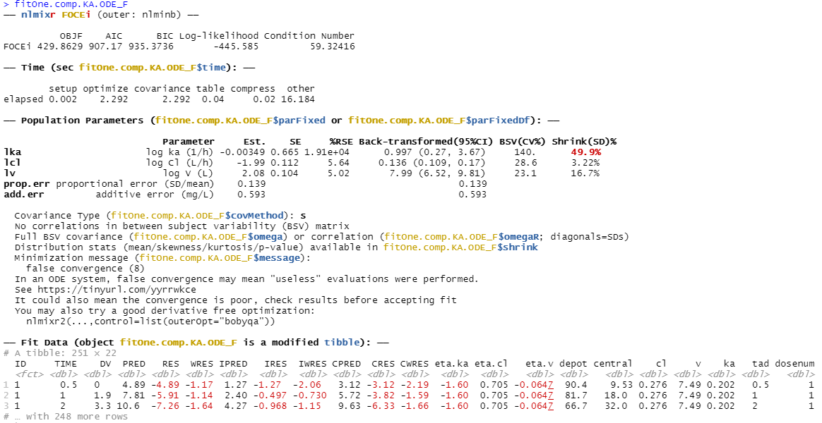
nlmixr² output for FOCEI with ODEs

Slide 68
Hands-on session III: running nlmixr² with ODEs and perform model development
Start at nlmixr analysis Part 2
Examine the code in PAGE_2.R to run a pre-programmed FOCEI analysis with ODEs
Examine the goodness of fit plots and implement alternative models for absorption (like one or more transit compartments…)

Slide 69
Running nlmixr²: 1 transit compartment
## 5 transit compartments One.comp.transit <- function() { ini({ # Where initial conditions/variables are specified lktr <- log(1.15) #log transit rate constant (/h) lcl <- log(0.135) #log Cl (L/h) lv <- log(8) #log V (L) prop.err <- 0.15 #proportional error (SD/mean) add.err <- 0.6 #additive error (mg/L) eta.ktr ~ 0.5 eta.cl ~ 0.1 eta.v ~ 0.1 }) model({ # Where the model is specified ktr <- exp(lktr + eta.ktr) cl <- exp(lcl + eta.cl) v <- exp(lv + eta.v) ## ODE example d/dt(depot) =-ktr*depot d/dt(central) = ktr*trans – (cl/v)*central d/dt(trans) = ktr*(depot - trans) ## where residual error is assumed to follow proportional and additive error central ~ prop(prop.err) + add(add.err) })}

Slide 70
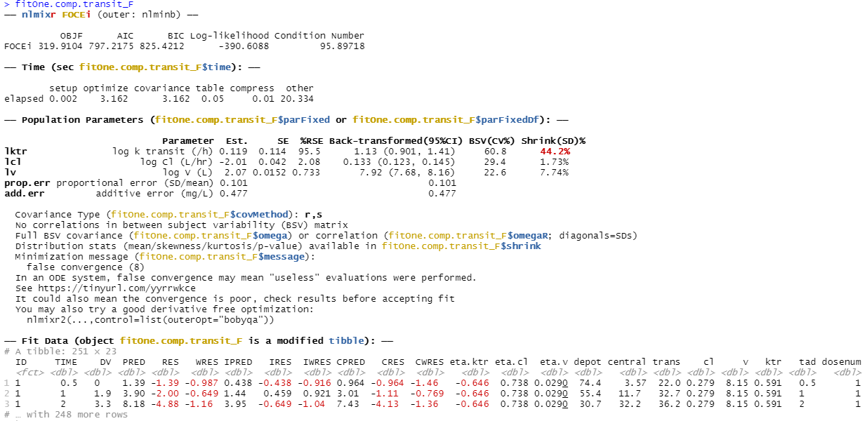
nlmixr² output: 1 transit compartment with ODEs using FOCEI

Slide 71
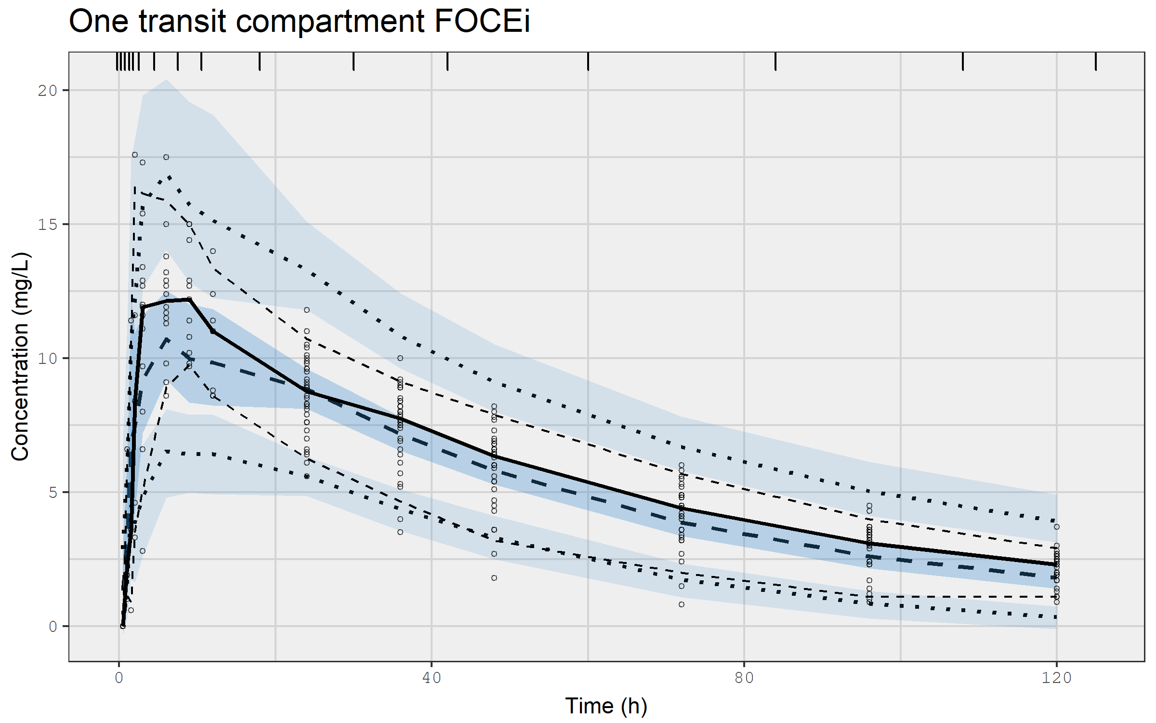
VPC for one compartment model with a transit compartment using FOCEI

Slide 72
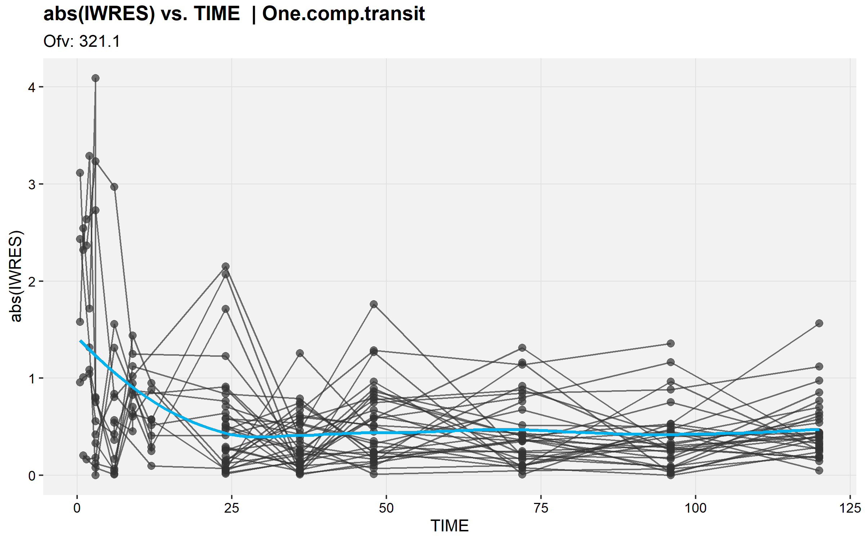
|IWRES| by time for first order absorption model with 1 transit compartment using FOCEi

Slide 73
Running nlmixr²: 5 transit compartments
## 5 transit compartments KA1tr5ode <- function() { ini({ # Where initial conditions/variables are specified lktr <- log(1.15) #log transit rate constant (/h) lcl <- log(0.135) #log Cl (L/h) lv <- log(8) #log V (L) prop.err <- 0.15 #proportional error (SD/mean) add.err <- 0.6 #additive error (mg/L) eta.ktr ~ 0.5 #IIV ktr eta.cl ~ 0.1 #IIV cl eta.v ~ 0.1 #IIV v }) model({ # Where the model is specified ktr <- exp(lktr + eta.ktr) cl <- exp(lcl + eta.cl) v <- exp(lv + eta.v) ## ODE example d/dt(depot) =-ktr*depot d/dt(central) = ktr*transit5 - cl* central/v d/dt(transit1)= ktr*(depot - transit1) d/dt(transit2)= ktr*(transit1 - transit2) d/dt(transit3)= ktr*(transit2 - transit3) d/dt(transit4)= ktr*(transit3 - transit4) d/dt(transit5)= ktr*(transit4 - transit5) ## where residual error is assumed to follow proportional and additive error central ~ prop(prop.err) + add(add.err) })}

Slide 74
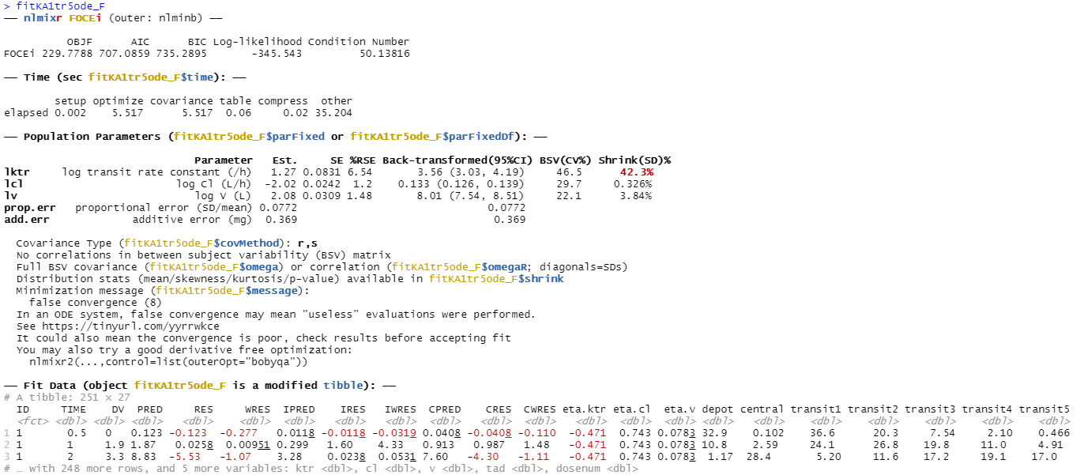
nlmixr² output: 5 transit compartments with ODEs using FOCEi

Slide 75
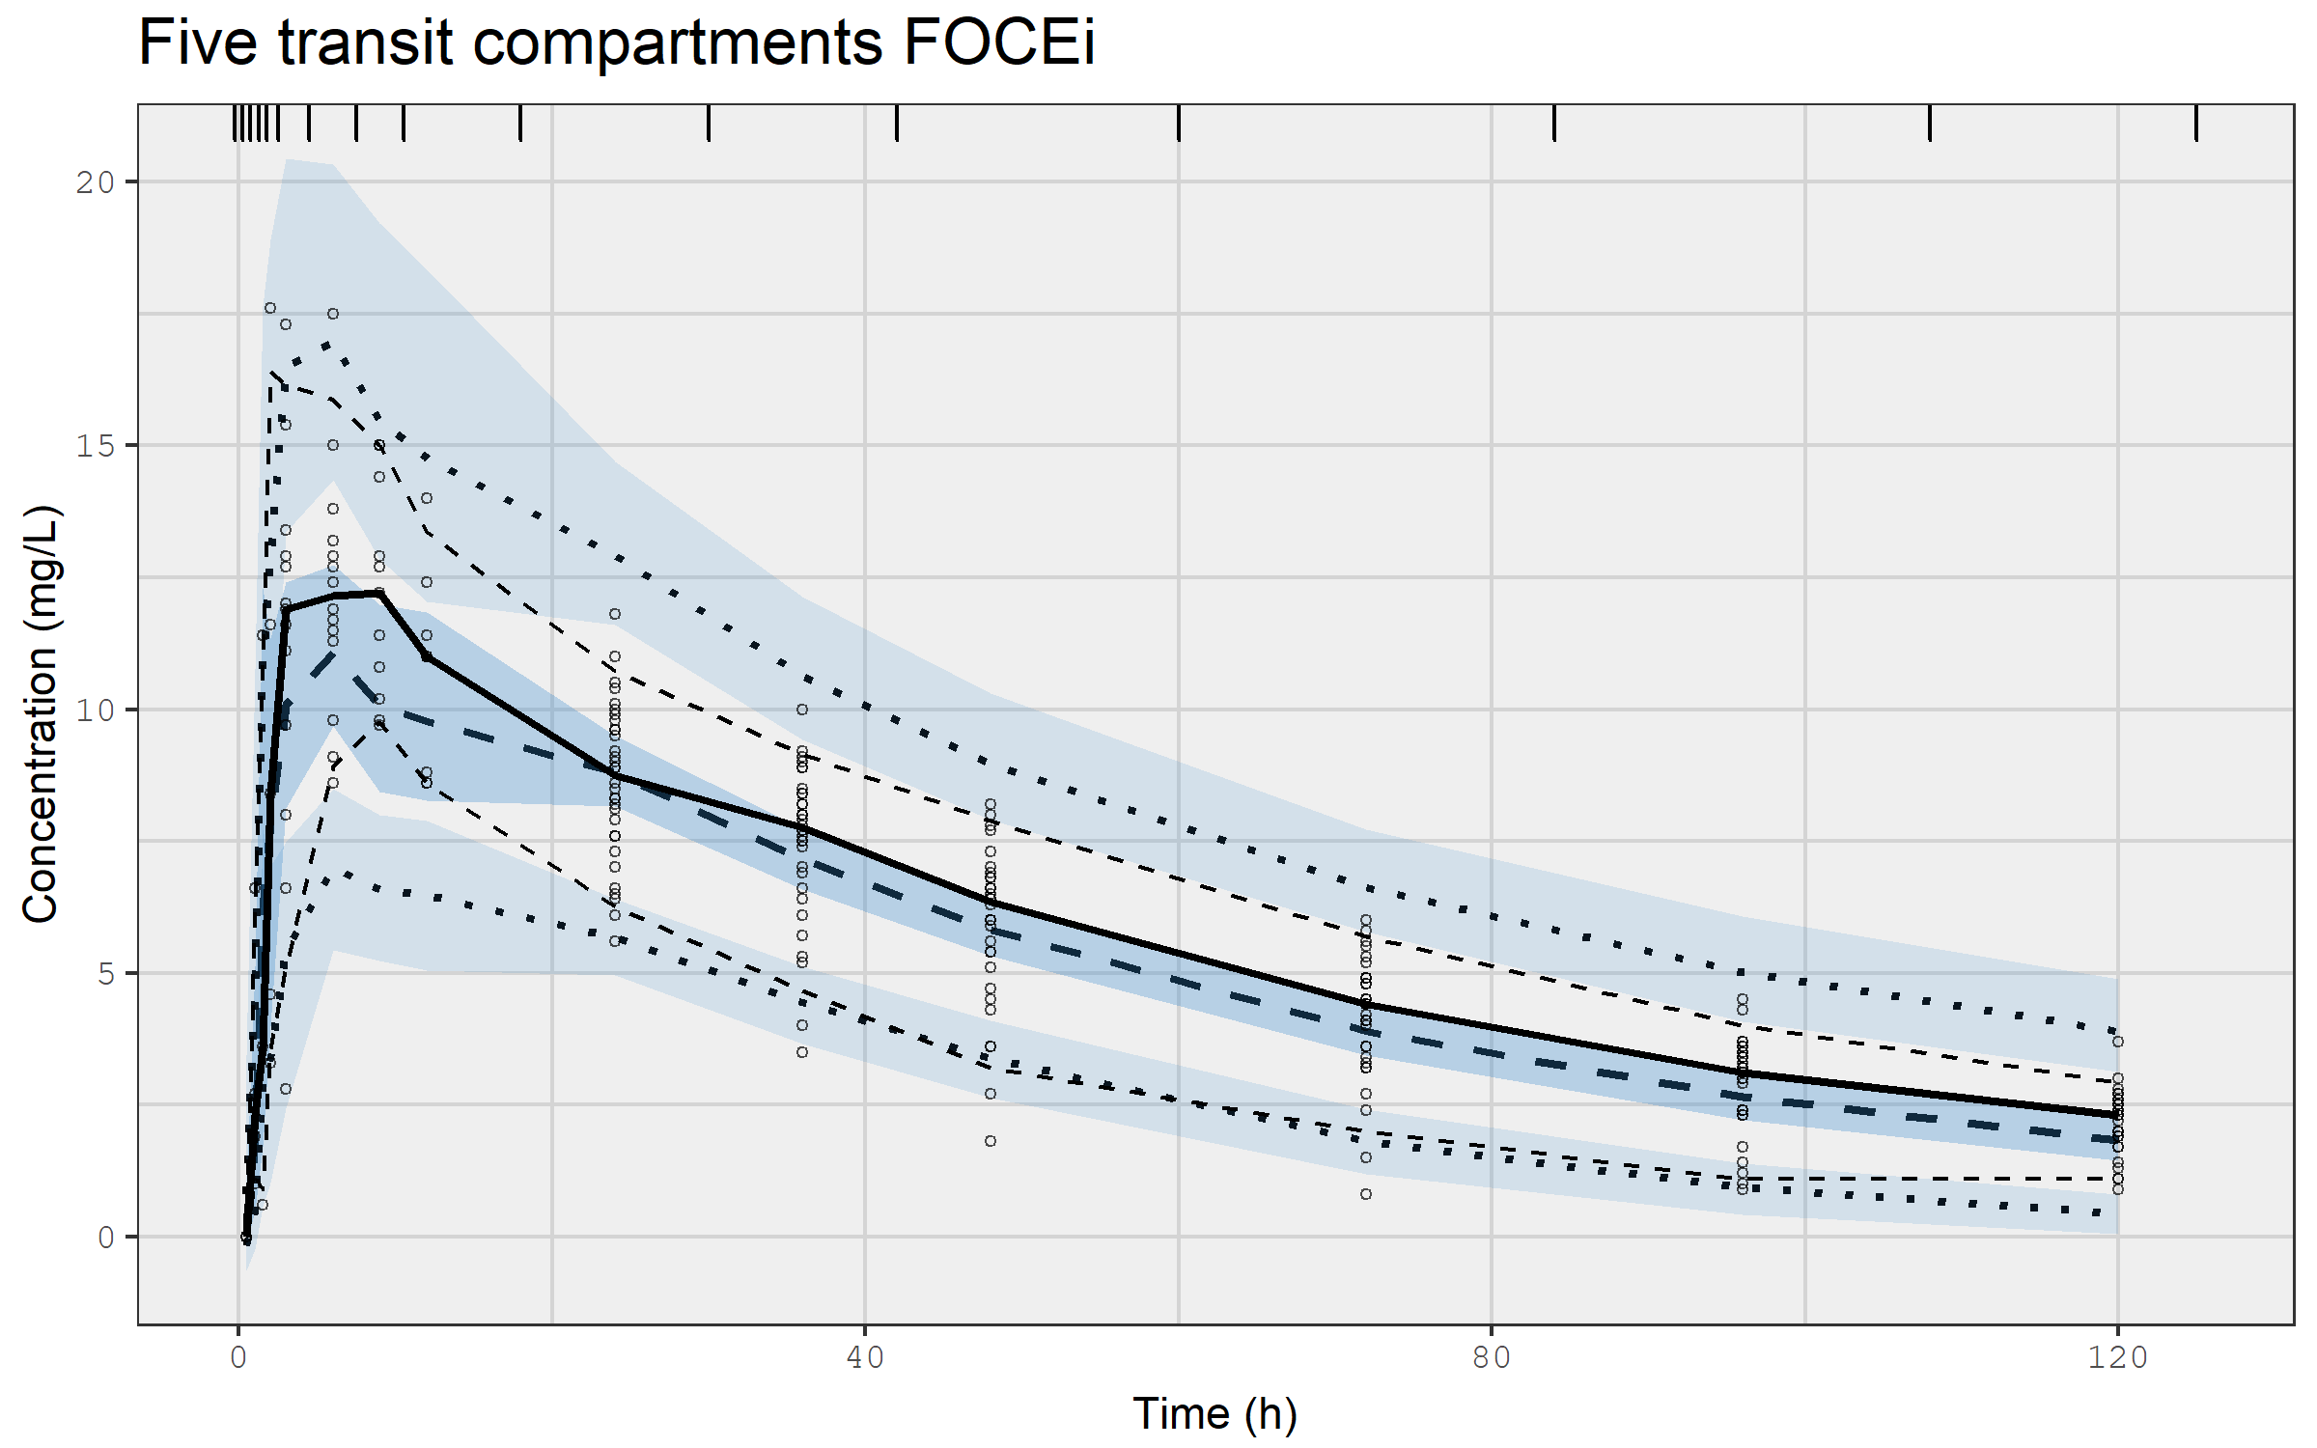
VPC for first order absorption with 5 transit compartments using FOCEi

Slide 76
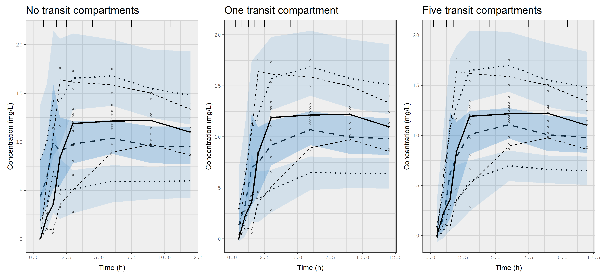
Comparing the VPCs for the first 12 hours to see if absorption is described better using zero, one, or five transit compartments

Slide 77
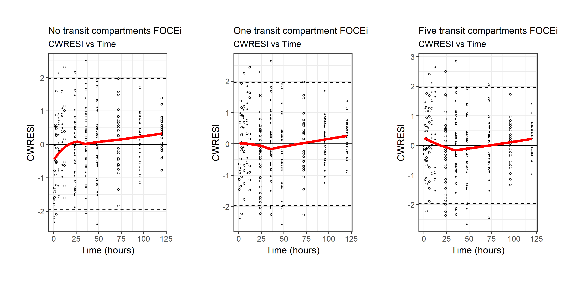
CWRESI for first order absorption with zero, one, and five transit compartments Not all diagnostics are always usefull to guide model updates

Slide 78
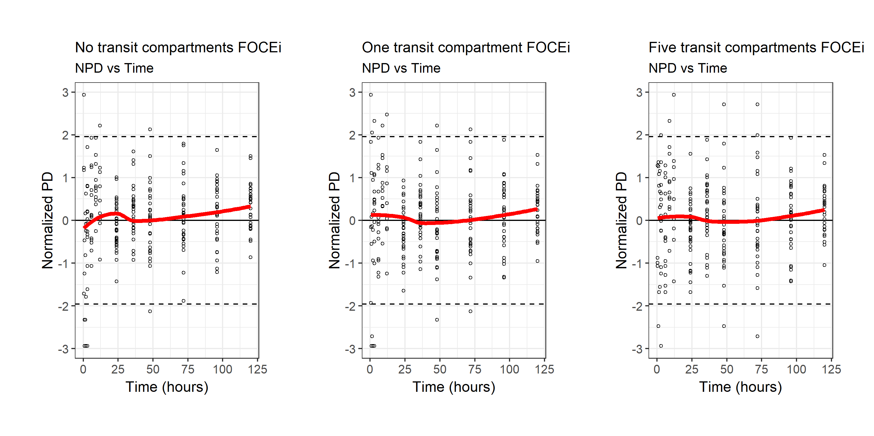
NPD for first order absorption with zero, one, and five transit compartments Not all diagnostics are always usefull to guide model updates

Slide 79
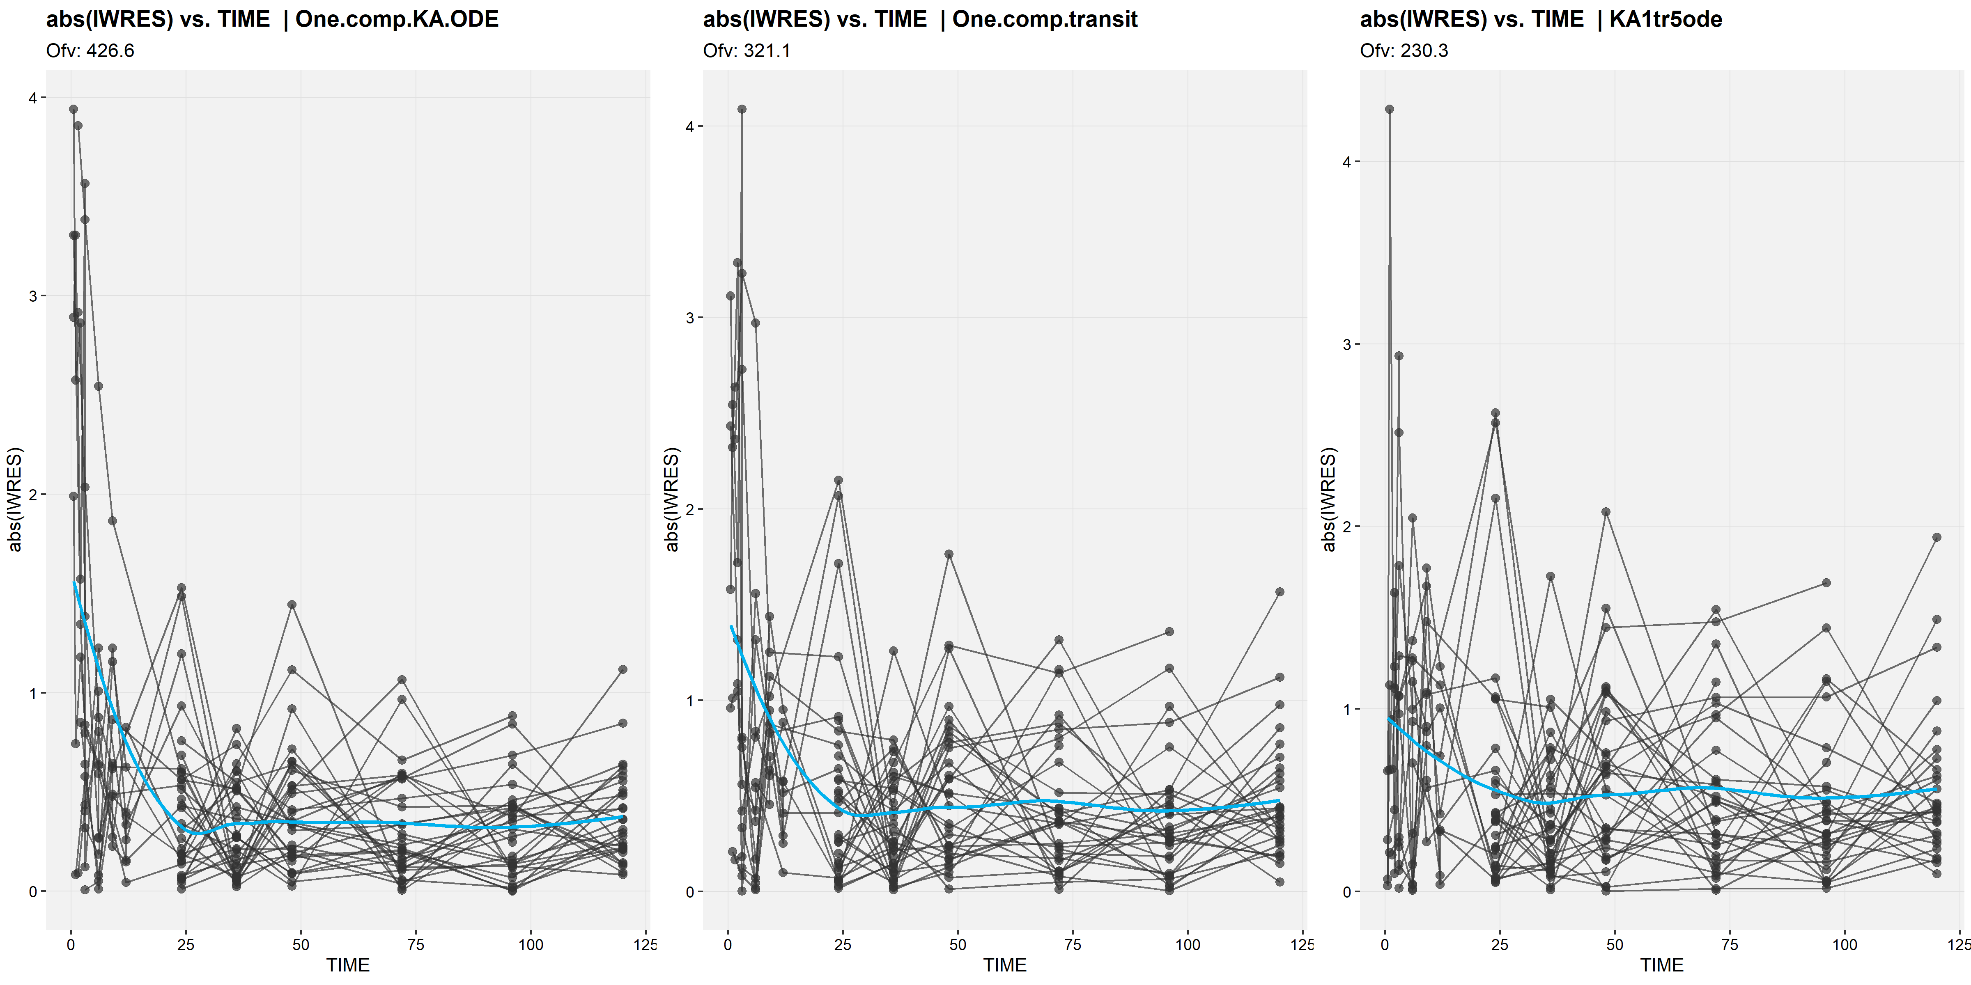
Comparison of |IWRESI| plots for different absorption models No transit compartment (left), one transit compartment (middle), 5 transit compartments (right)

Slide 80
Objective function values and estimation algorithms
When you request cwres=TRUE for an SAEM analysis, nlmixr calculates an FOCEI-type objective function value, and FOCEi-type conditional weighted residuals
However, this does not mean that they can be formally (or even informally) compared: as with NONMEM, comparisons should only ever be performed with nested models using the same estimation algorithm
Differences in OFV are not an indication of superiority of estimates obtained from one algorithm over another

Slide 81
nlmixr² can generate empirical Bayes estimates for Bayesian feedback: individual EBEs for a new data set using existing population parameters
KA1tr5posthoc <- function() { ini({ # Specify previously obtained population estimates (e.g. from NONMEM or nlmixr) lktr <- 1.18994619 #log ktr (/h) lcl <- -2.01737477 #log Cl (L/h) lv <- 2.06631620 #log V (L) prop.err <- 0.07883633 #proportional error (SD/mean) add.err <- 0.37249666 #additive error (mg/L) eta.ktr ~ 0.2532964 eta.cl ~ 0.08073339 eta.v ~ 0.04490733 }) model({ cl <- exp(lcl + eta.cl) v <- exp(lv + eta.v) ktr <- exp(lktr + eta.ktr) d/dt(trns1) = -ktr * trns1 d/dt(trns2) = ktr * trns1 - ktr * trns2 d/dt(trns3) = ktr * trns2 - ktr * trns3 d/dt(trns4) = ktr * trns3 - ktr * trns4 d/dt(trns5) = ktr * trns4 - ktr * trns5 d/dt(central) = ktr * trns5 - (cl/v) * central cp = central/v cp ~ prop(prop.err) + add(add.err) }) } fitKA1tr5_Fph <- nlmixr(KA1tr5posthoc, PKdata,
est = "posthoc") # Specify posthoc as estimation method
Useful in a therapeutic drug monitoring setting
Or for generating exposure estimates with a particularly nasty model that you do not want to refit on new data ☺

Slide 82
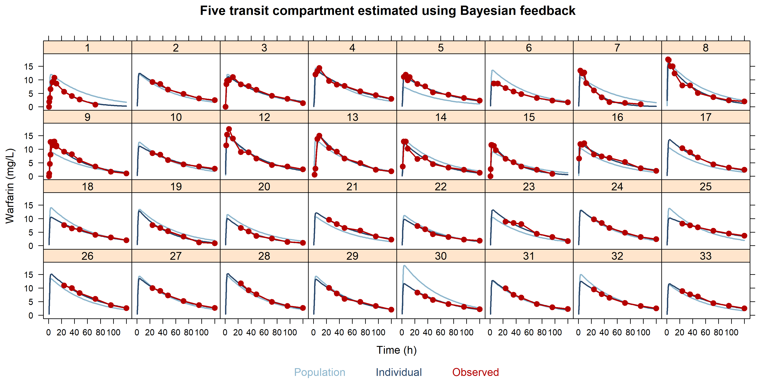
Individual graphs for the five transit compartment model estimated using Bayesian feedback; perfect fit even though there was no actual parameter estimation

Slide 83
Parameterisation and mu-referencing
For SAEM, parameters must be defined using 'mu-referencing’
This means that inter-individual variability parameters must be added onto population parameters
This implies estimating log-parameters with the IIV added on the log-scale
For FOCEi, mu-referencing is not strictly required, but is shown to provide superior estimation results
For a binary covariate (e.g. sex 0/1), the back-transformed estimate is a fold-change that can be re-written as a percentage change

Slide 84
Corresponding nlmixr² code
## One compartment transit model with Sex on V KAtr1_sexV <- function() { ini({ lktr <- log(1.15) #log k transit (/h) lcl <- log(0.135) #log CL (L/h) lv <- log(8) #log V (L) Sex_V <- 0.1 #log Sex on v prop.err <- 0.15 #proportional error (SD/mean) add.err <- 0.6 #additive error (mg/L) eta.ktr ~ 0.5 eta.cl ~ 0.1 eta.v ~ 0.1 }) model({ #Sex on volume cl <- exp(lcl + eta.cl) v <- exp(lv + eta.v + Sex_V * SEX) #the SEX covariate is 0 or 1 in the data set ktr <- exp(lktr + eta.ktr) d/dt(depot) = -ktr * depot d/dt(central) = ktr * trans - (cl/v) * central d/dt(trans) = ktr * depot - ktr * trans cp = central/v cp ~ prop(prop.err) + add(add.err) })

Slide 85
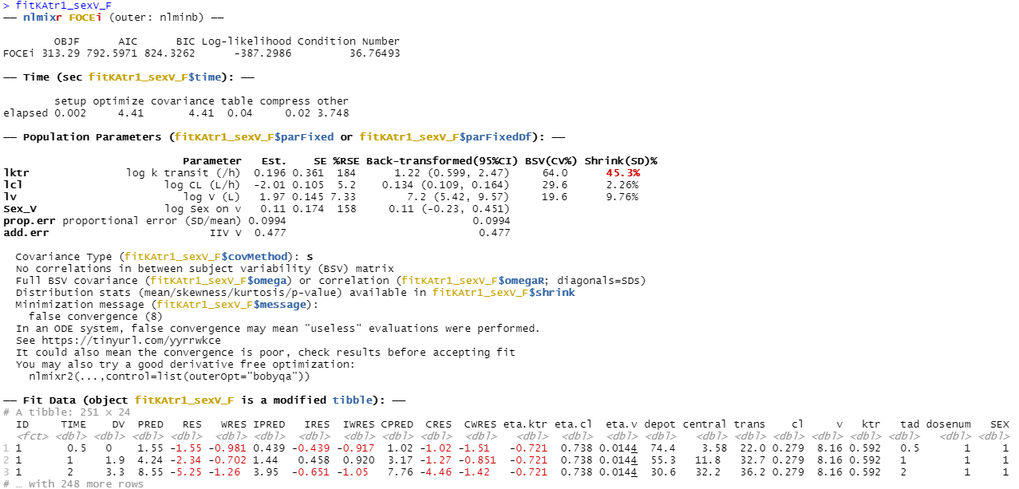
nlmixr² output: mu-referenced sex on V (log-scale)

Slide 86
Parameterisation and mu-referencing
For a binary covariate (e.g. sex 0/1; female/males), the back-transformed estimate is a fold-change that can be re-written as a percentage change
The estimated 0.110 (95%CI: -0.230/0.451) translates using
exp(c(0.110, -0.230, 0.451))
to a fold-change estimate of 1.116 (95%CI: 0.794/1.569)
which corresponds to an increase of 11.6% (95%CI: -20.6%/56.9%)
for males compared to females

Slide 87
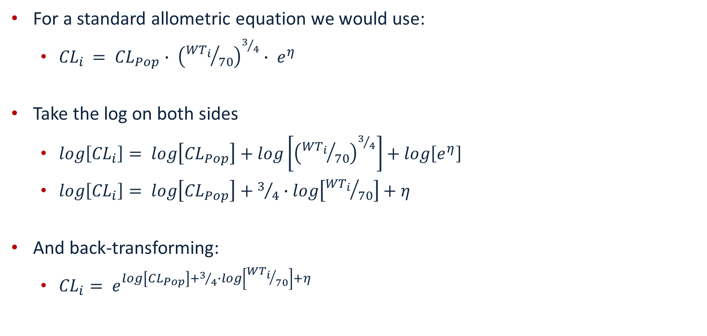
mu-referencing and allometric scaling
For a standard allometric equation we would use:
${CL}_{i }= {CL}_{Pop}∙ {\left({{WT}_{i}}/{70}\right)}^{3/4}∙ e^{η}$
Take the log on both sides
$log\left[{CL}_{i}\right]= log\left[{CL}_{Pop}\right]+log\left[{\left({{WT}_{i}}/{70}\right)}^{3/4}\right]+log\left[e^{η}\right]$
$log\left[{CL}_{i}\right]= log\left[{CL}_{Pop}\right]+3/4∙log\left[{{WT}_{i}}/{70}\right]+η$
And back-transforming:
${CL}_{i}= e^{log\left[{CL}_{Pop}\right]+3/4∙log\left[{{WT}_{i}}/{70}\right]+η}$

Slide 88
Corresponding nlmixr² code
Code is most stable if transformations are carried out in the data file instead of in the model code, especially for SAEM:
## Using standard R syntax: PKdata$logWT70 <- log(PKdata$WT/70) ## Or using data.table syntax PKdata[,logWT70:=log(WT/70)]

Slide 89
Corresponding nlmixr² code: allometric scaling
One.comp.transit.allo <- function() { ini({ lktr <- log(1.15) #log k transit (/h) lcl <- log(0.15) #log Cl (L/hr) lv <- log(7) #log V (L) ALLC <- fix(0.75) #allometric exponent cl ALLV <- fix(1.00) #allometric exponent v prop.err <- 0.15 #proportional error (SD/mean) add.err <- 0.6 #additive error (mg/L) eta.ktr ~ 0.5 eta.cl ~ 0.1 eta.v ~ 0.1 }) model({ #Allometric scaling on weight cl <- exp(lcl + eta.cl + ALLC * logWT70) v <- exp(lv + eta.v + ALLV * logWT70) ktr <- exp(lktr + eta.ktr) d/dt(depot) = -ktr * depot d/dt(central) = ktr * trans - (cl/v) * central d/dt(trans) = ktr * depot - ktr * trans cp = central/v cp ~ prop(prop.err) + add(add.err) }) }

Slide 90
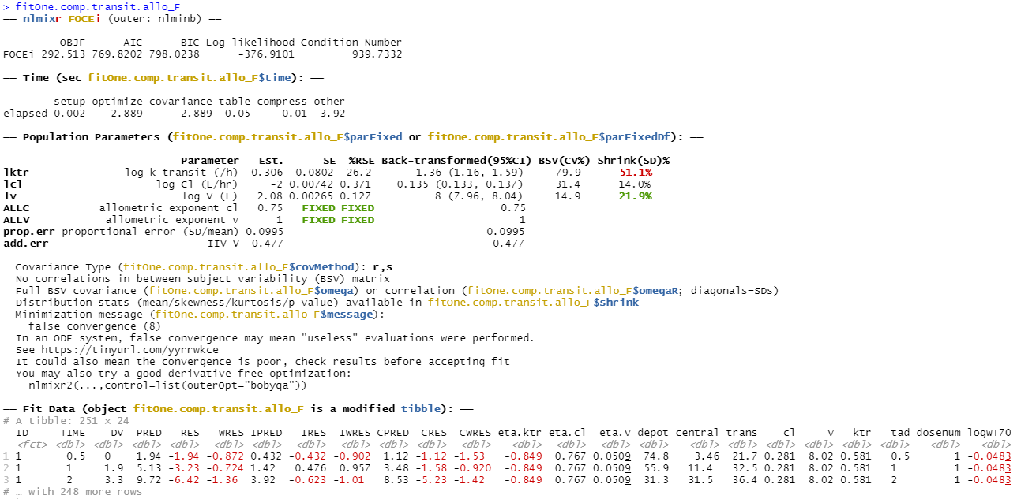
nlmixr² output: allometric scaling ODEs using FOCEi Change in OFV compared to model without allometric scaling: -27.4

Slide 91
Hands-on session IV: running an nlmixr² posthoc analysis and implementing covariates using mu-referencing
Examine the code in PAGE_4.R to run a posthoc analysis
Examine the code in PAGE_4.R to run a covariate analysis with additive on log-scale covariate implementation
Binary covariate (sex)
Continuous covariate (weight)
Modify the allometrically scaled model with fixed exponents to examine what happens when you set them free

Slide 92
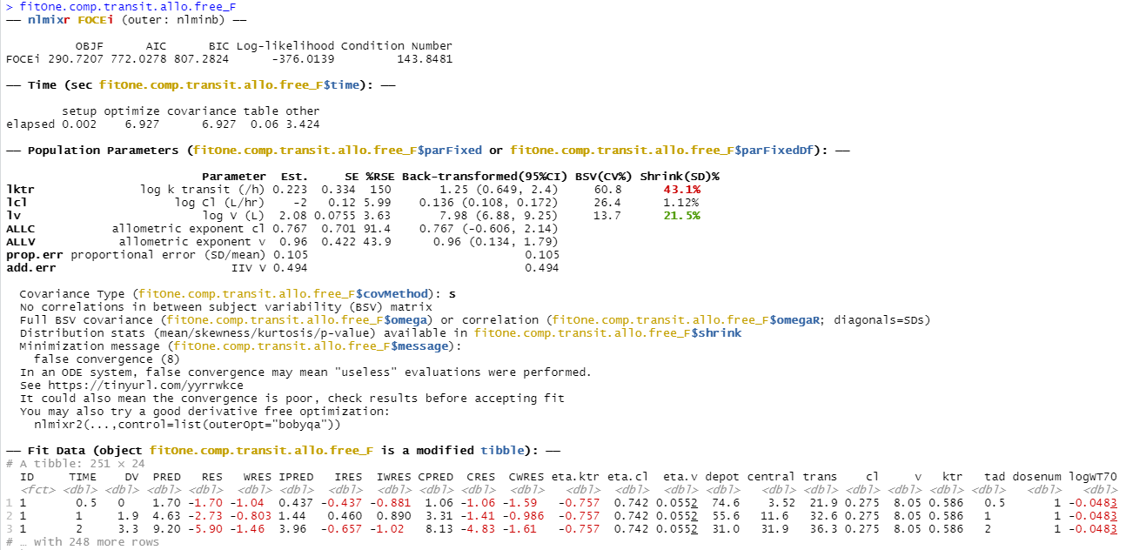
nlmixr² output: allometric scaling ODEs using FOCEI Freely estimated exponents: drop of only 1.79 points

Slide 93
PKPD analysis with nlmixr²: sequential estimation
First approach: use EBEs from a previous PK model to define PK profiles and estimate PKPD relationship
Extract EBEs from nlmixr object and merge to PKPD data file
load(file = "fitOne.comp.transit.allo_F.Rdata") #Use the one compartment transit model to start the PD analysis EBEs <- as.data.table(fitOne.comp.transit.allo_F) EBEs <- EBEs[!duplicated(ID), .(ID = as.numeric(as.character(ID)), IKTR = ktr, ICL = cl, IV = v)] PKPDdata <- fread("warfarin_dat.csv")
#Change variable names to upper case (not strictly necessary) setnames(PKPDdata, names(dataF), toupper(names(dataF)))
#Generate MDV data items PKPDdata[, MDV := ifelse(is.na(DV), 1, 0)] PKPDdata[, MDV := ifelse(AMT > 0, 1, MDV)]
#Merge data with PK EBEs PDdata <- merge(PKPDdata, EBEs, by = "ID", all.x = TRUE)
#Mark the PK measurements from the file to not be analysed PDdata[, MDV := ifelse(DVID == 1 & AMT == 0, 1, MDV)]

Slide 94
PKPD analysis with nlmixr²: define turnover model using PK EBEs
KA1tr1IPP_PDtoemax1 <- function() { ini({ tc50 <- log(1) #log ec50 (mg/L) tkout <- log(0.05) #log tkout (/h) te0 <- log(100) #log e0 eta.c50 ~ .5 eta.kout ~ .1 eta.e0 ~ .1 eps.pdadd <- 100 }) model({ c50 = exp(tc50 + eta.c50) kout = exp(tkout + eta.kout) e0 = exp(te0 + eta.e0) # PK parameters from input data set ktr = IKTR cl = ICL v = IV cp = central/v PD = 1 - cp/(c50 + cp) effect(0) = e0 kin = e0 * kout d/dt(depot) = -ktr * depot d/dt(central) = ktr * trans - cl/v * central d/dt(trans) = ktr * depot - ktr * trans d/dt(effect) = kin * PD - kout * effect effect ~ add(eps.pdadd) }) }

Slide 95
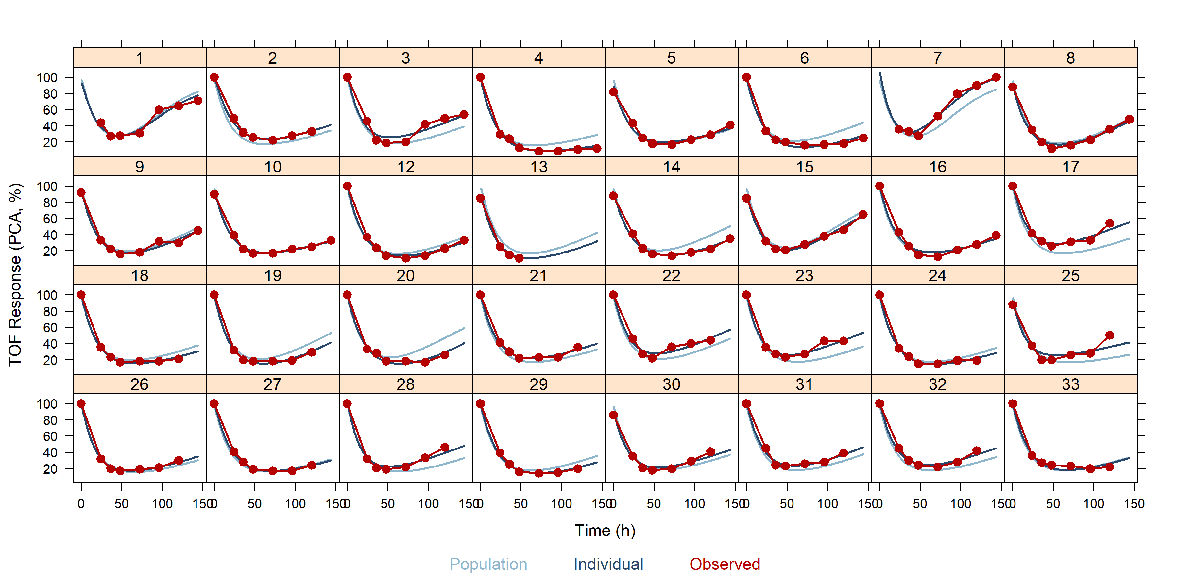
Individual graphs for turnover Emax PD model with PK using EBEs

Slide 96
Hands-on session V: running a sequential nlmixr² PKPD analysis
Examine the code in PAGE_5.R to generate a data file with EBEs to describe the PK-part of the PKPD model
Run the sequential PKPD analysis

Slide 97
PKPD analysis with nlmixr²: simultaneous estimation
Second approach: estimate PK and PD simultaneously
The source of observations is identified using a dvid data item
dvid is coded as central and effect in the data object to identify the two types of observation as presented in the model code

Slide 98
Immediate effect simultaneous PKPD analysis with nlmixr²: ini block
#Immediate effect KA1tr1_PDimmemax1 <- function() { ini({ ## PK tktr <- log(1) # log ktr (/h) tcl <- log(0.1) # log CL (L/h) tv <- log(8) # log Vc (L) eta.ktr ~ 1 eta.cl ~ 0.1 eta.v ~ 0.1 eps.pkprop <- 0.1 #proportional error (SD/mean) eps.pkadd <- 0.4 #additive error (mg/L)
## PD tc50 <- log(1) #log ec50 (mg/L) te0 <- log(100) #log e0 eta.c50 ~ .5 eta.e0 ~ .1 eps.pdadd <- 100 }) model({
}) }

Slide 99
Immediate effect simultaneous PKPD analysis with nlmixr²: model block
#Immediate effect model({ ktr <- exp(tktr + eta.ktr) cl <- exp(tcl + eta.cl) v <- exp(tv + eta.v) c50 = exp(tc50 + eta.c50) e0 = exp(te0 + eta.e0) cp = central/v d/dt(depot) = -ktr * depot d/dt(central)= ktr * trans - cl * cp d/dt(trans) = ktr * depot - ktr * trans effect = e0 * (1 - cp/(c50 + cp)) cp ~ prop(eps.pkprop) + add(eps.pkadd) | central effect ~ add(eps.pdadd) | effect }) }

Slide 100
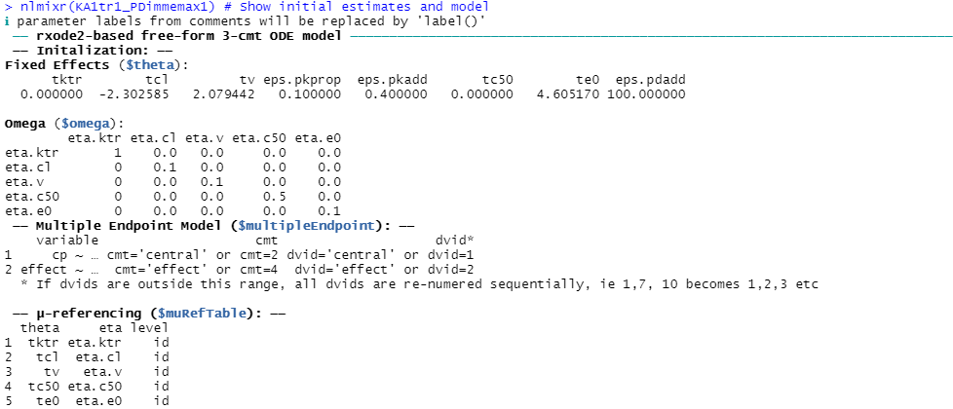
Simultaneous PKPD analysis with nlmixr²: examine defined model
nlmixr(KA1tr1_PDimmemax1) # Show initial estimates and model information:

Slide 101
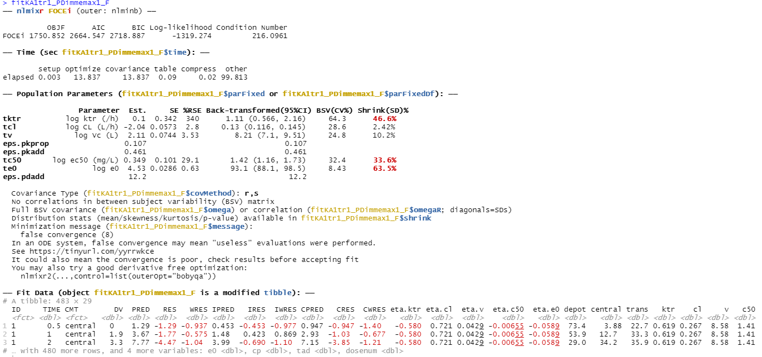
nlmixr output: immediate effect simultaneous PKPD model

Slide 102
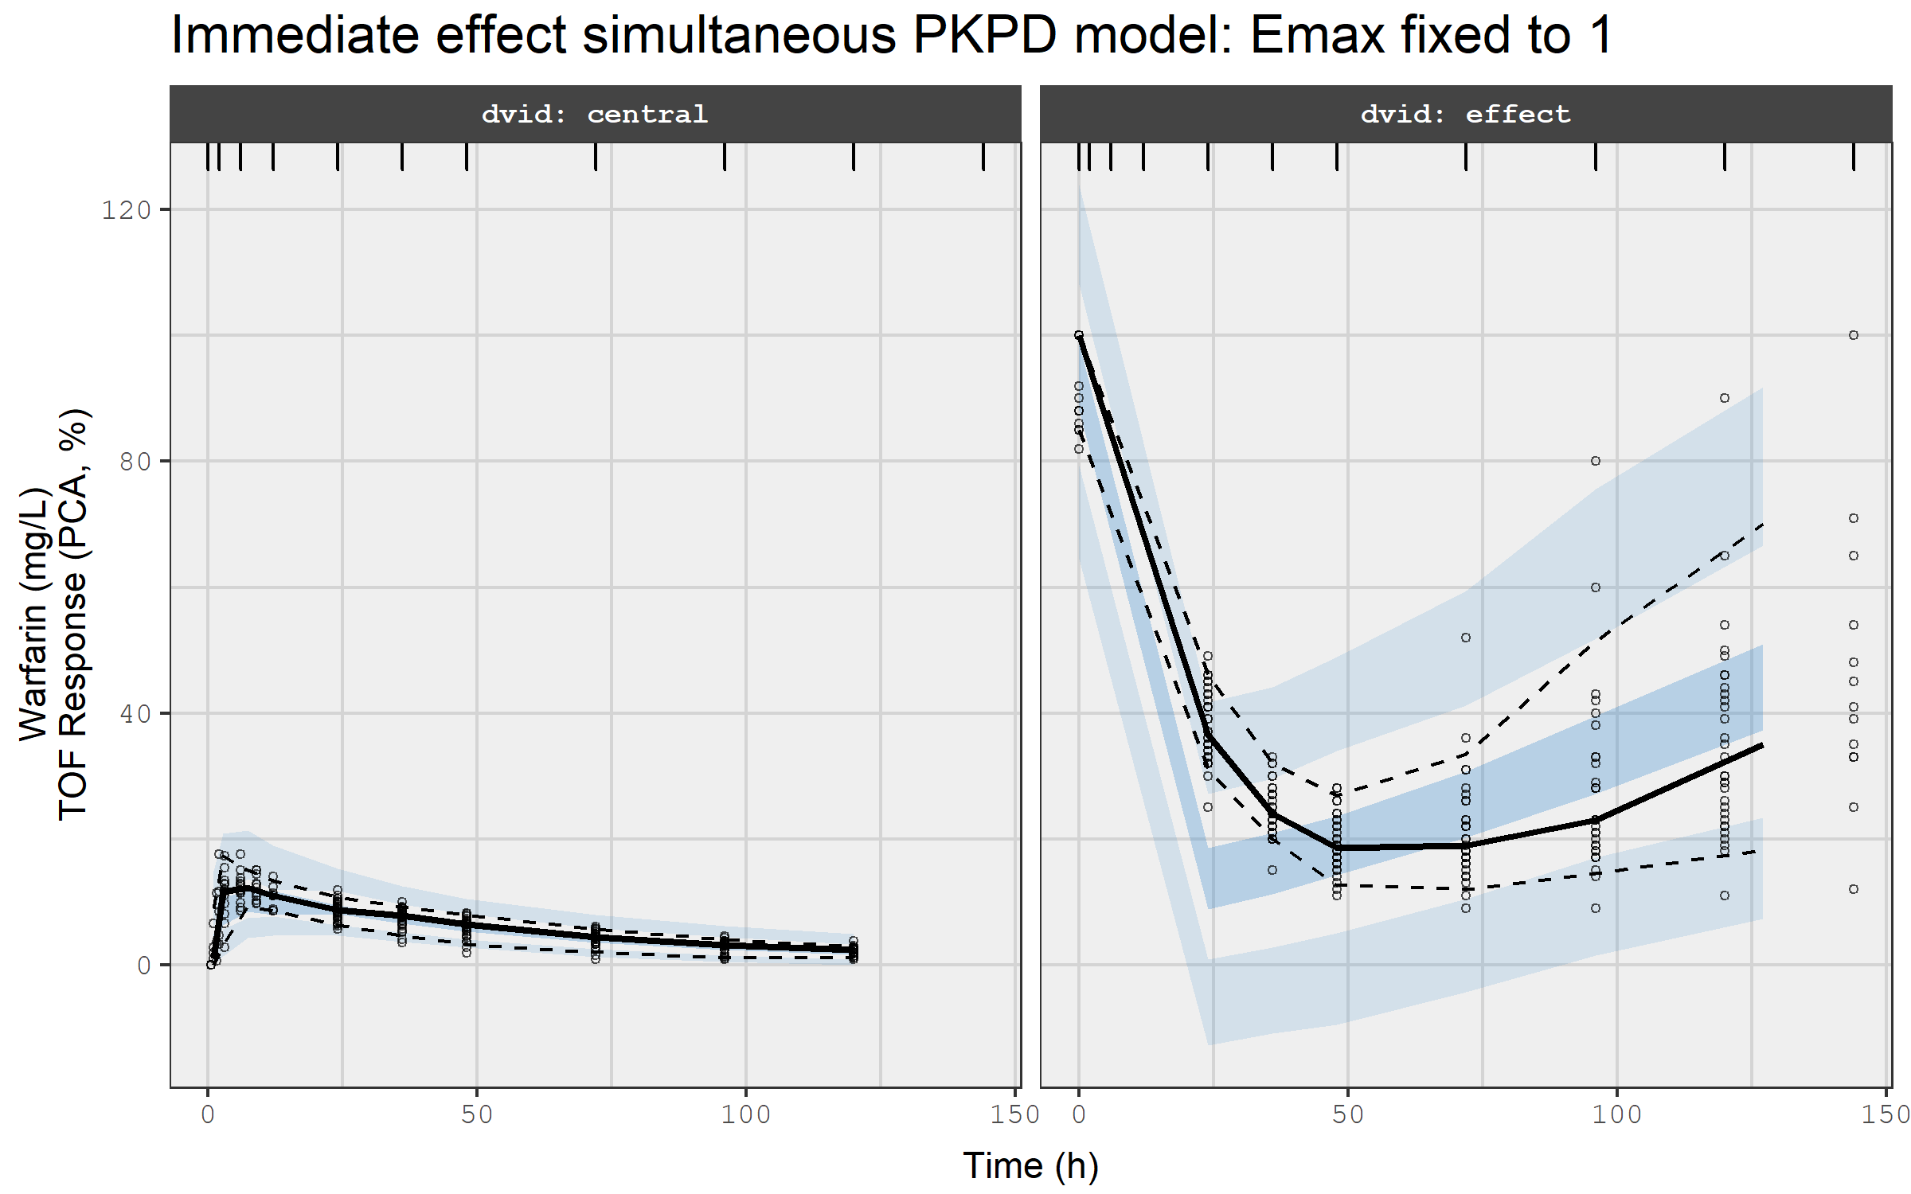
VPC for immediate effect simultaneous PKPD model

Slide 103
Effect compartment simultaneous PKPD analysis with nlmixr²: ini block
#Effect compartment model KA1tr1_PDceemax <- function() { ini({ ## PK tktr <- log(1) # log ktr (/h) tcl <- log(0.1) # log CL (L/h) tv <- log(8) # log Vc (L) eta.ktr ~ 1 eta.cl ~ 0.1 eta.v ~ 0.1 eps.pkprop <- 0.1 #proportional error (SD/mean) eps.pkadd <- 0.4 #additive error (mg/L) ## PD tc50 <- log(1) #log ec50 (mg/L) tkout <- log(0.05) #log tkout (/h) te0 <- log(100) #log e0 eta.c50 ~ .5 eta.kout ~ .1 eta.e0 ~ .1 eps.pdadd <- 100 }) model({
}) }

Slide 104
Effect compartment simultaneous PKPD analysis with nlmixr²: model block
#Effect compartment model model({ ktr <- exp(tktr + eta.ktr) cl <- exp(tcl + eta.cl) v <- exp(tv + eta.v) c50 = exp(tc50 + eta.c50) kout = exp(tkout + eta.kout) e0 = exp(te0 + eta.e0) emax = 1 cp = central/v d/dt(depot) = -ktr * depot d/dt(central)= ktr * trans - cl * cp d/dt(trans) = ktr * depot - ktr * trans d/dt(ce) = kout * (cp - ce) effect = e0 * (1 - emax * ce/(c50 + ce)) cp ~ prop(eps.pkprop) + add(eps.pkadd) | central effect ~ add(eps.pdadd) | effect }) }

Slide 105

nlmixr² output: effect compartment simultaneous PKPD model

Slide 106

VPC for effect compartment simultaneous PKPD model

Slide 107
Turnover model simultaneous PKPD analysis with nlmixr²: ini block
#Turnover simultaneous PKPD model KA1tr1IPP_PDtoemax <- function() { ini({ ## PK tktr <- log(1) # log ktr (/h) tcl <- log(0.1) # log CL (L/h) tv <- log(8) # log Vc (L) eta.ktr ~ 1 eta.cl ~ 0.1 eta.v ~ 0.1 eps.pkprop <- 0.1 # proportional error (SD/mean) eps.pkadd <- 0.4 # additive error (mg/L) ## PD tc50 <- log(1) #log ec50 (mg/L) tkout <- log(0.05) #log tkout (/h) te0 <- log(100) #log e0 eta.c50 ~ .5 eta.kout ~ .1 eta.e0 ~ .1 eps.pdadd <- 100 }) model({
}) }

Slide 108
Turnover model simultaneous PKPD analysis with nlmixr²: model block
#Turnover simultaneous PKPD model model({ ktr <- exp(tktr + eta.ktr) cl <- exp(tcl + eta.cl) v <- exp(tv + eta.v) c50 = exp(tc50 + eta.c50) kout = exp(tkout + eta.kout) e0 = exp(te0 + eta.e0) emax = 1 cp = central/v d/dt(depot) = -ktr * depot d/dt(central)= ktr * trans - cl * cp d/dt(trans) = ktr * depot - ktr * trans effect(0) = e0 kin = e0 * kout PD = 1 - emax * cp/(c50 + cp) d/dt(effect) = kin * PD - kout * effect cp ~ prop(eps.pkprop) + add(eps.pkadd) | central effect ~ add(eps.pdadd) | effect }) }

Slide 109

nlmixr² output: turnover simultaneous PKPD model

Slide 110

VPC for turnover simultaneous PKPD model

Slide 111

VPCs to compare the immediate effect model, the effect compartment model, and the turnover simultaneous PKPD model

Slide 112
Hands-on session VI: running a simultaneous nlmixr² PKPD analysis
Examine the code in PAGE_5.R to run one of the simultaneous PKPD analyses

Slide 113
Individual graphs with multiple endpoints currently require advanced RxODE tricks: eventTable for multiple subjects
RxODE examples so far have only been for a single subject
The eventTable can define multiple subjects as well: you can even use a NONMEM data set for this (it has time points and doses)
Start with a table of doses
Create an eventTable using et(Doses) and cook these together with simulation time points using et(0, 150, by = 0.5) with the help of magrittr piping (%>%)
Create a table of EBEs
#Generate a data.table of doses Doses <- dataF[AMT > 0, .(ID, TIME, AMT, EVID = 1)]
#Generate an eventTable by combining the doses with the same set of fine-meshed sampling points for all subjects using the et function and magrittr (%>%) piping evt <- et(Doses) %>% et(0, 150, by = 0.5)
#Generate a data.table of EBEs: the nlmixr fit object contains EBEs EBEs_KA1tr1_PDimmemax1_F <- data.table(fitKA1tr1_PDimmemax1_F)
#Take only the first record for each ID:
EBEs_KA1tr1_PDimmemax1_F <- EBEs_KA1tr1_PDimmemax1_F[!duplicated(ID), .(ID, ktr, cl, v, c50, e0)]

Slide 114
Individual graphs with multiple endpoints currently require advanced RxODE tricks: simulate…
#Define the RxODE model modPKPD0 <- RxODE({ cp = central/v d/dt(depot) = -ktr * depot d/dt(trans) = ktr * depot - ktr * trans d/dt(central)= ktr * trans - cl * cp effect = e0 * (1 - cp/(c50 + cp)) }) #Solve the system: res1 <- data.table(rxSolve(modPKPD0, EBEs_KA1tr1_PDimmemax1_F, evt))
#Merge with observed data points Rdata <- PKPDdata[MDV == 0, .(id = factor(ID), time = TIME, DVID, DV)] xx1 <- merge(res1, Rdata, by = c("id", "time"), all.x = TRUE)

Slide 115
…and plot
#And plot: xyplot( DV + effect ~ time | id, data = xx1[DVID == 2 | is.na(DVID)], type = c("b", "l"), col = nlmixCOLS[c(3, 2)], main = "PCA profiles for the immediate effect simultaneous PKPD model", cex = c(1, 0.1), layout=c(8,4), lwd = 2, pch = c(19, 1), xlab = "Time (h)\n", ylab = "TOF Response (PCA, %)", as.table = TRUE, scales = list(alternating = 1) )
But if I know Matt, he'll soon update augPred to cover multiple endpoints ☺

Slide 116

Individual graphs for warfarin PK of the immediate effect simultaneous PKPD model

Slide 117

Individual graphs for PCA profiles for the immediate effect simultaneous PKPD model

Slide 118

Individual graphs for PCA profiles for the simultaneous PKPD effect-compartment model

Slide 119

Individual graphs for PCA profiles for the simultaneous PKPD turnover model

Slide 120
Hands-on session VII: simulate and plot individual profiles using RxODE
Examine the code in PAGE_5.R to extract EBEs from the simultaneous PKPD model you ran
Generate a fine-meshed population eventTable
Update the RxODE model to match the model you actually ran
Simulate and plot the results

